Slide 1
It’s All About Jobs
Michael Corbit
Vice President

Slide 2
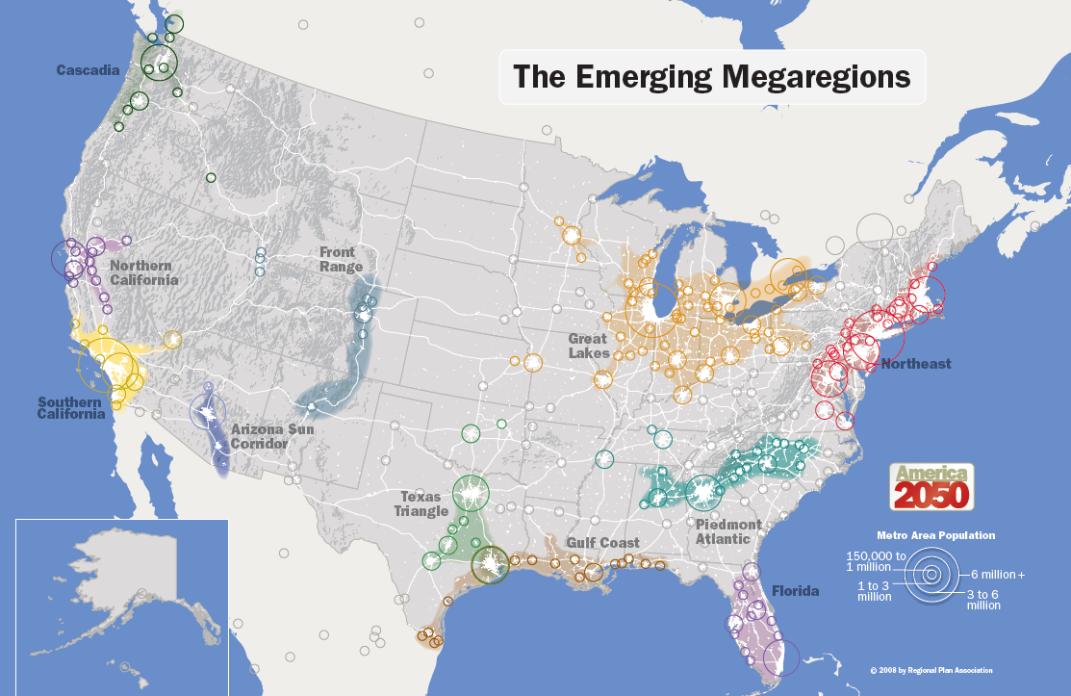
The Emerging Megaregions
Notes:
It’s about JOBS!

Slide 3
Jobs
10,706,000
Florida Labor Force
US 3.3% FL 2.6% PBC 2.6%
Unemployment Rate
Florida gained 443,600 jobs (4.9%) over the last 12 months
526,487
Available Jobs In Florida*
$47.9 – PBC
$51.6 - FL
Average Annual Salary for
Top 20 In-Demand Occupations*
$68,331 – PBC
$60,299 - FL
Average Annual Wage
34,449 job openings vs. 20,428 unemployed people in September
Notes:
It’s about JOBS!

Slide 4
Job Gains
By the numbers, over-the-year job gains in Palm Beach County were:
Industry Change Total jobs
Leisure/hospitality +11,100 92,100
Education/health services +7,100 109,700
Trade/transportation/utilities +4,500 121,300
Other services +4,500 jobs 35,000
Construction +1,000 jobs 40,300
Manufacturing +1,100 jobs 21,500
Financial activities +800 jobs 46,900
Government +800 jobs 63,800
Professional/business services +300s 125,800
Information unchanged 10,600
Notes:
This study will describe several archetypes – or worker types – that will help us understand workforce needs and design policy recommendations and interventions. We’re working with CareerSource staff to refine this framework and will test these with businesses and local boards.
But, we know from national literature and survey data that there are several types of workers out there.
The Subscriber – these may be dedicated gigsters, working full-time probably through a web-based platform. This could be a software coder, a graphic designer, a paralegal or other high skill professionals. These are the dedicated workers who are fully subscribed to the opportunities of the gig economy.
The Reluctant – these workers could be doing any type of jobs or tasks – but they’re doing so out of necessity. Either for additional income or because other traditional job opportunities are limited. This could be someone like an elementary teacher or adjunct professor who is teaching online courses in addition to their traditional jobs.
The Alternative – these workers are those whose only viable choice is alternative work arrangements. This could be an ex-felon or disabled worker or anyone who is adept behind a keyboard, but not necessarily in the usual work environment.
The Supplementer – these workers are looking to earn a little bit more income, not necessarily out of necessity, but by choice. They recognize that the gig economy has potential, but they’re just dipping their toe in. This could be someone driving for Uber, or picking up piece work doing technical editing or legal work – for more pocket money around the holidays.
The Retiree- There may be fewer gig workers who are older than we think, but we know that many elderly are facing uncertain incomes or are just interested in continuing to work for income or social interaction. These could be drivers, business mentors, greeters, and those even volunteering their time.
The Enthusiast – These workers may be engaged in the gig economy by choice, because they want to be. They could be crafting goods to sell on Etsy, freelance photographers, or serving on Boards and/or working with non-profits, or exploring the entrepreunerial potential that the gig economy offers.

Slide 5
Defining the Gig Economy
8,046,000
Full-time workers
Traditional
Work Arrangements
Full or part-time wage and salary workers
Self-employed/non-employers in own incorporated business
Non-Traditional
Work Arrangements
Remote workers
Independent contractors
Seasonal workers
Temporary agency workers
On-call or contract workers
Unpaid family workers
856,100
Staffing agency workers
1,667,000
Part-time workers
500,400
Remote workers
Alternative
Work
Arrangements
375,829
Self-employed in incorporated business
280,000
Workers holding multiple jobs
745,931
Full-time workers with direct purchase health insurance
276,549
Self-employed in unincorporated business
Notes:
We truly don’t know the size and the scope of the gig economy. We know, from public statistics, that there are traditional and non-traditional work arrangements. These are the blue and orange circles – from labor statistics we can measure those arrangements and track employment and unemployment.
What we can’t really track and measure with labor market data – are the emerging alternative work arrangements – the gig economy. These are the various types of work arrangements in the gig economy – noted here in the green circle.
This includes workers doing work online or in-person mediated through web-based platforms, as well as workers producing goods, renting homes, driving cars, and a wide range of professional services.
We do know that TECHNOLOGY is enabling and underpinning the gig economy.
We do know that there is a lot of OVERLAP with traditional work arrangements – many gig workers also hold full or part time jobs and many known non-traditional arrangements, such as contractors, temp workers, seasonal workers, and on-call workers are sometimes counted as being in the gig economy.
One of the outcomes of this study will be a common definition of the gig economy for CareerSource Florida.

Slide 6
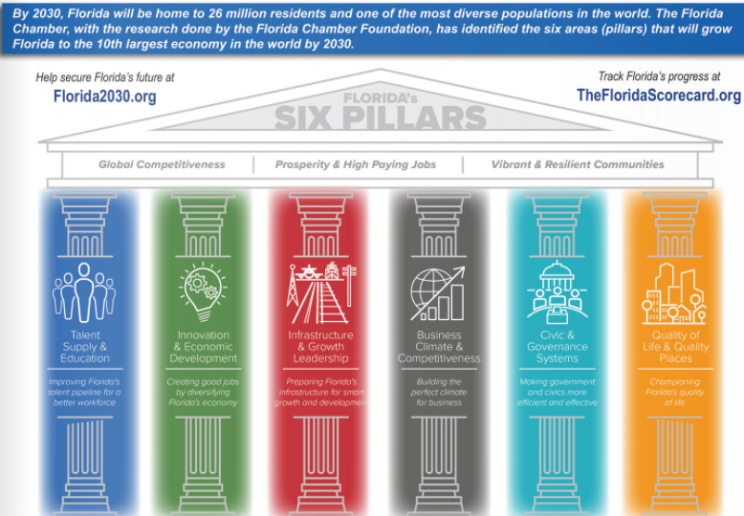
Florida2030.org

Slide 7
Training Grants – Incentive Programs
On-the-Job Training (OJT)
Train specific set of skills at the worksite
New employee
Customized Training (CT)
Additional training to upgrade skills
Obtain national or industry certificate
Incumbent Worker Training (IWT)
State funding for customized training
Existing for-profit businesses

Slide 8
Veterans’ Services
Connecting veterans to civilian career opportunities
Recognized among nation’s top 10 most successful
veterans employment programs
More than doubled veterans’ employment 2017-2018
Strong relationships with business, social service
and education sectors

Slide 9
Youth and Young Adult Programs
Business & Entrepreneurship
Hospitality
Trades
Healthcare
CareerSource has specialized services for jobseekers between the ages of 17 to 24. Jobseekers:
Improve skills to become job ready
Explore educational requirements for careers, vocations, and apprenticeships
Work based experiences to include internships and On-the-Job Training

Slide 10
Disability Services Department
Assisting individuals with disabilities to find and maintain meaningful work.
Department Branches:
Ticket To Work
Disabilities Services Support
Community Work Incentive Coordinator (CWIC)
Hospitality Training Program of Palm Beaches
REACH Conference
Project Impact
Job Search Assistance
Job Coaching (Short-term)

Slide 11
Prepare Re-entry Program
Pre-Release Employment Preparation and Re-entry Engagement program
Provides inmates employment services during and after incarceration
Career planning and counseling
Case management and assessment
Resume preparation/writing
Peer support groups
Interviewing skills

Slide 12
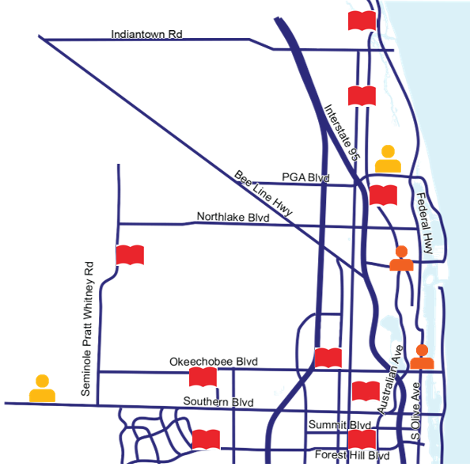
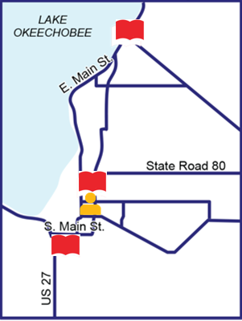
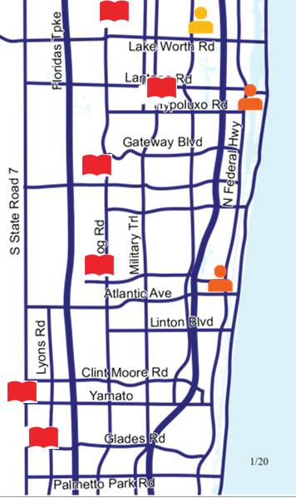
CSPBC Library Footprint
2 Centers
4 City Libraries with CSPBC Staff
17 Libraries with trained staff
CSPBC recruiters at PBSC
More University, Adult Education campuses coming in the Fall ’21

Slide 13
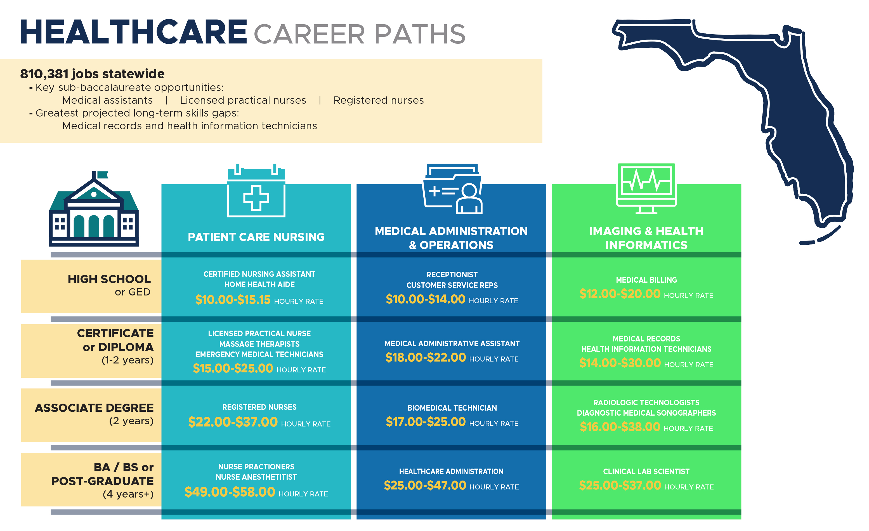
Healthcare Career Paths
134,347
Projected jobs available for
healthcare through 2025
8%
Projected jobs growth through 2025

Slide 14
Learner Pathway for Healthcare Careers
School District Choice Programs
Florida Atlantic University
Lynn University
Palm Beach Atlantic University
Nova Southeastern University
South University
Barry University
Adult and Community Education
Palm Beach State College
Keiser University
Southeastern University
Allied Health Assisting
Medical Lab Assisting
Emergency Medical Responder
Health Unit Coordinator
Practical Nursing
Electrocardiograph (EKG) Aide
Electrocardiograph Tech
Nursing Assistant
Pharmacy Technician
Home Health Aide (HHA)
Exercise Science
Home Health Aide (HHA)
Electrocardiograph (EKG)
Phlebotomy
Certificate - Sonography
Certificate - Medical Assistant Specialist
Certificate - PCA
Certificate - LPN
Certificate - MRI
Certificate - Tomography
AA - Nursing
AA - Community Health
AA - Pharmaceutical
AS - Health Services Mgmt.
AS - Medical Assist
AS - Nursing
AS - Ophthalmic Tech
AS - Radiography
AS - Sonography
AS - Respiratory Care
AS - Surgical Services
BS - RN to BSN
BS - Cardiopulmonary Sciences
RN - BSN
BS - Behavioral Neuroscience
BS - Medicinal Chemistry
MSN - Health Science
MS - Health Science
MS - Clinical Mental Health Counseling
DNP - Adult Gerontology (AGPCNP)
DNP - Executive Leadership
DNP - Family Nurse Practitioner
PharmD
Certificate - Healthcare Mgmt.
BS - Healthcare Mgmt.
MBA - Healthcare Mgmt.
AS - Ultrasound
AS - Medical Assisting
AS - Nuclear Med Tech
AS - Nursing
AS - Occupational Therapy
AS - Physical Therapy
AS - Respiratory Therapy
AS - Surgical Tech
BA - Dietetics & Nutrition
BA - Health Science
BA - Health Admin
BA - Psychology
DC - Chiropractic
DNAP
DHSc - Health Science
Nurse Anesthesia
DNP Nursing Practice, Psychology
BS - Pre-Health Professional
RN to BSN
MS - Nursing
MS - Health Science
MS -School Counseling
Doctor of Nursing Practice
BS - Health Informatics
BS - Health Science
BS - Human Services Admin
MS - Counseling
MS - Psychology
MS - Health Informatics
MS - Health Law
MS - Health Sciences,
MS - Nursing
MSN - Public Health (MPH)
BS - Pharmacy
BS - Nursing (RN to BS)
AS - Allied Health Science
AS - Medical Assisting
AS - Occupational Therapy Assistant
AS - Physical Therapy Assistant
BA - Psychology
BSN - RN to BSN
BS - Healthcare Management
MS - Mental Health Counseling
MS - Anesthesia Science
MS -Healthcare Administration
MS - Physician Assistant
Certificate - Case Mgmt.
Certificate - Pharm Tech
Graduate Certificate - Healthcare Leadership
Graduate Certificate - Gerontology
BS - Health Services Admin
BS - Clinical Social Work
BS - Pre-Dental, Medical, Optometry, Pharmacy, Physical Therapy, Physician Assist, Podiatry
MS - Mental Health Counseling
MBA - Health Services Administration
Doctor - Occupational Therapy
Doctor - Podiatric Medicine
PhD - Nursing
Internships and Employment

Slide 15
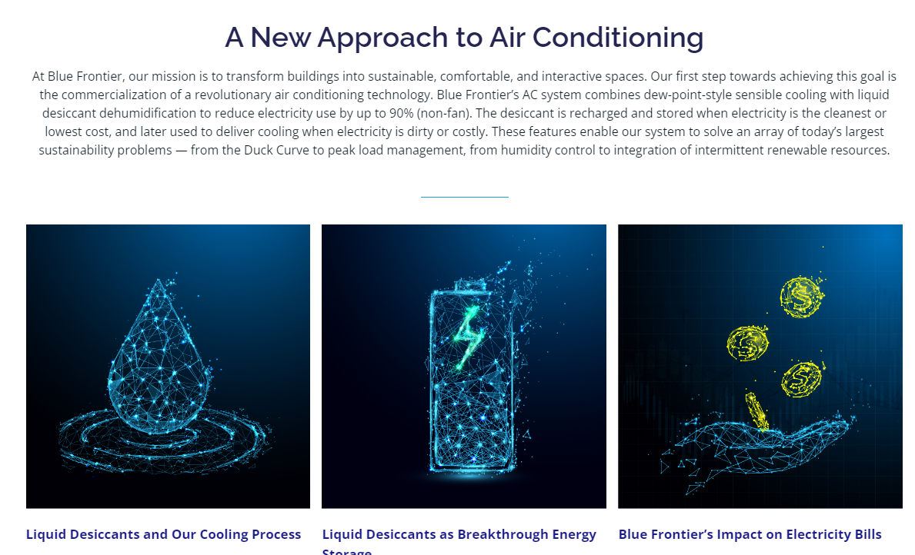
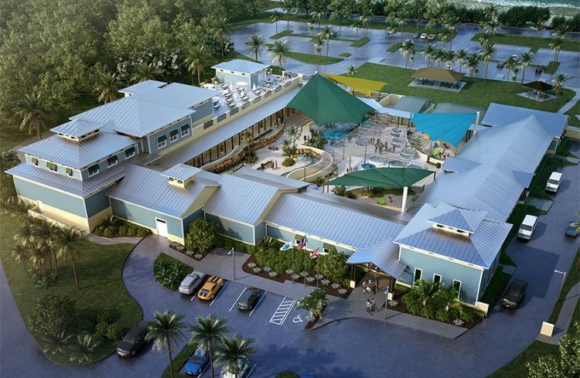
New Projects
Project Rack
Project Cypress

