Slide 1
Palm Beach County Transportation Disadvantaged Local Coordinating Board Member Training

Slide 2
Training Outline
Transportation Disadvantaged (TD) Program
Local Coordinating Board (LCB) Overview
LCB Duties
LCB Administration

Slide 3
Transportation Disadvantaged (TD) Program

Slide 4
Transportation Disadvantaged Program
 | Commission for Transportation Disadvantaged | Designated Official Planning Agency | Community Transportation Coordinator | Local Coordinating Board
Acronym | CTD | DOPA | CTC | LCB
Purpose | Coordinates TD transportation services | Assists CTD at local level | Coordinates & provides transportation services in Palm Beach County | Identifies local service needs & advise CTC

Slide 5
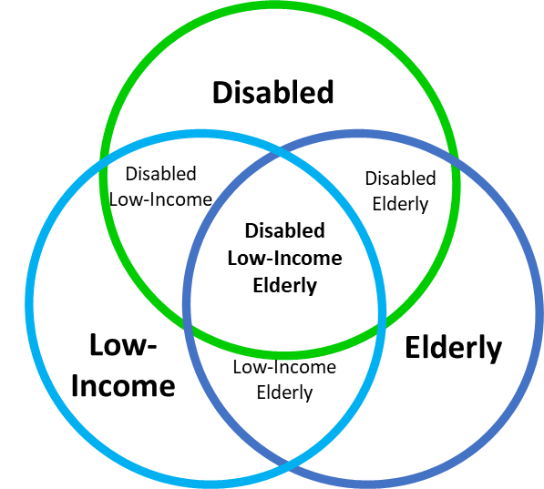
Transportation Disadvantaged
Describes those persons who because of physical or mental disability, income status, or age are unable to transport themselves or to purchase transportation.

Slide 6
Commission for the Transportation Disadvantaged (CTD)
Independent state agency created to accomplish the coordination of transportation services provided to the transportation disadvantaged population.

Slide 7
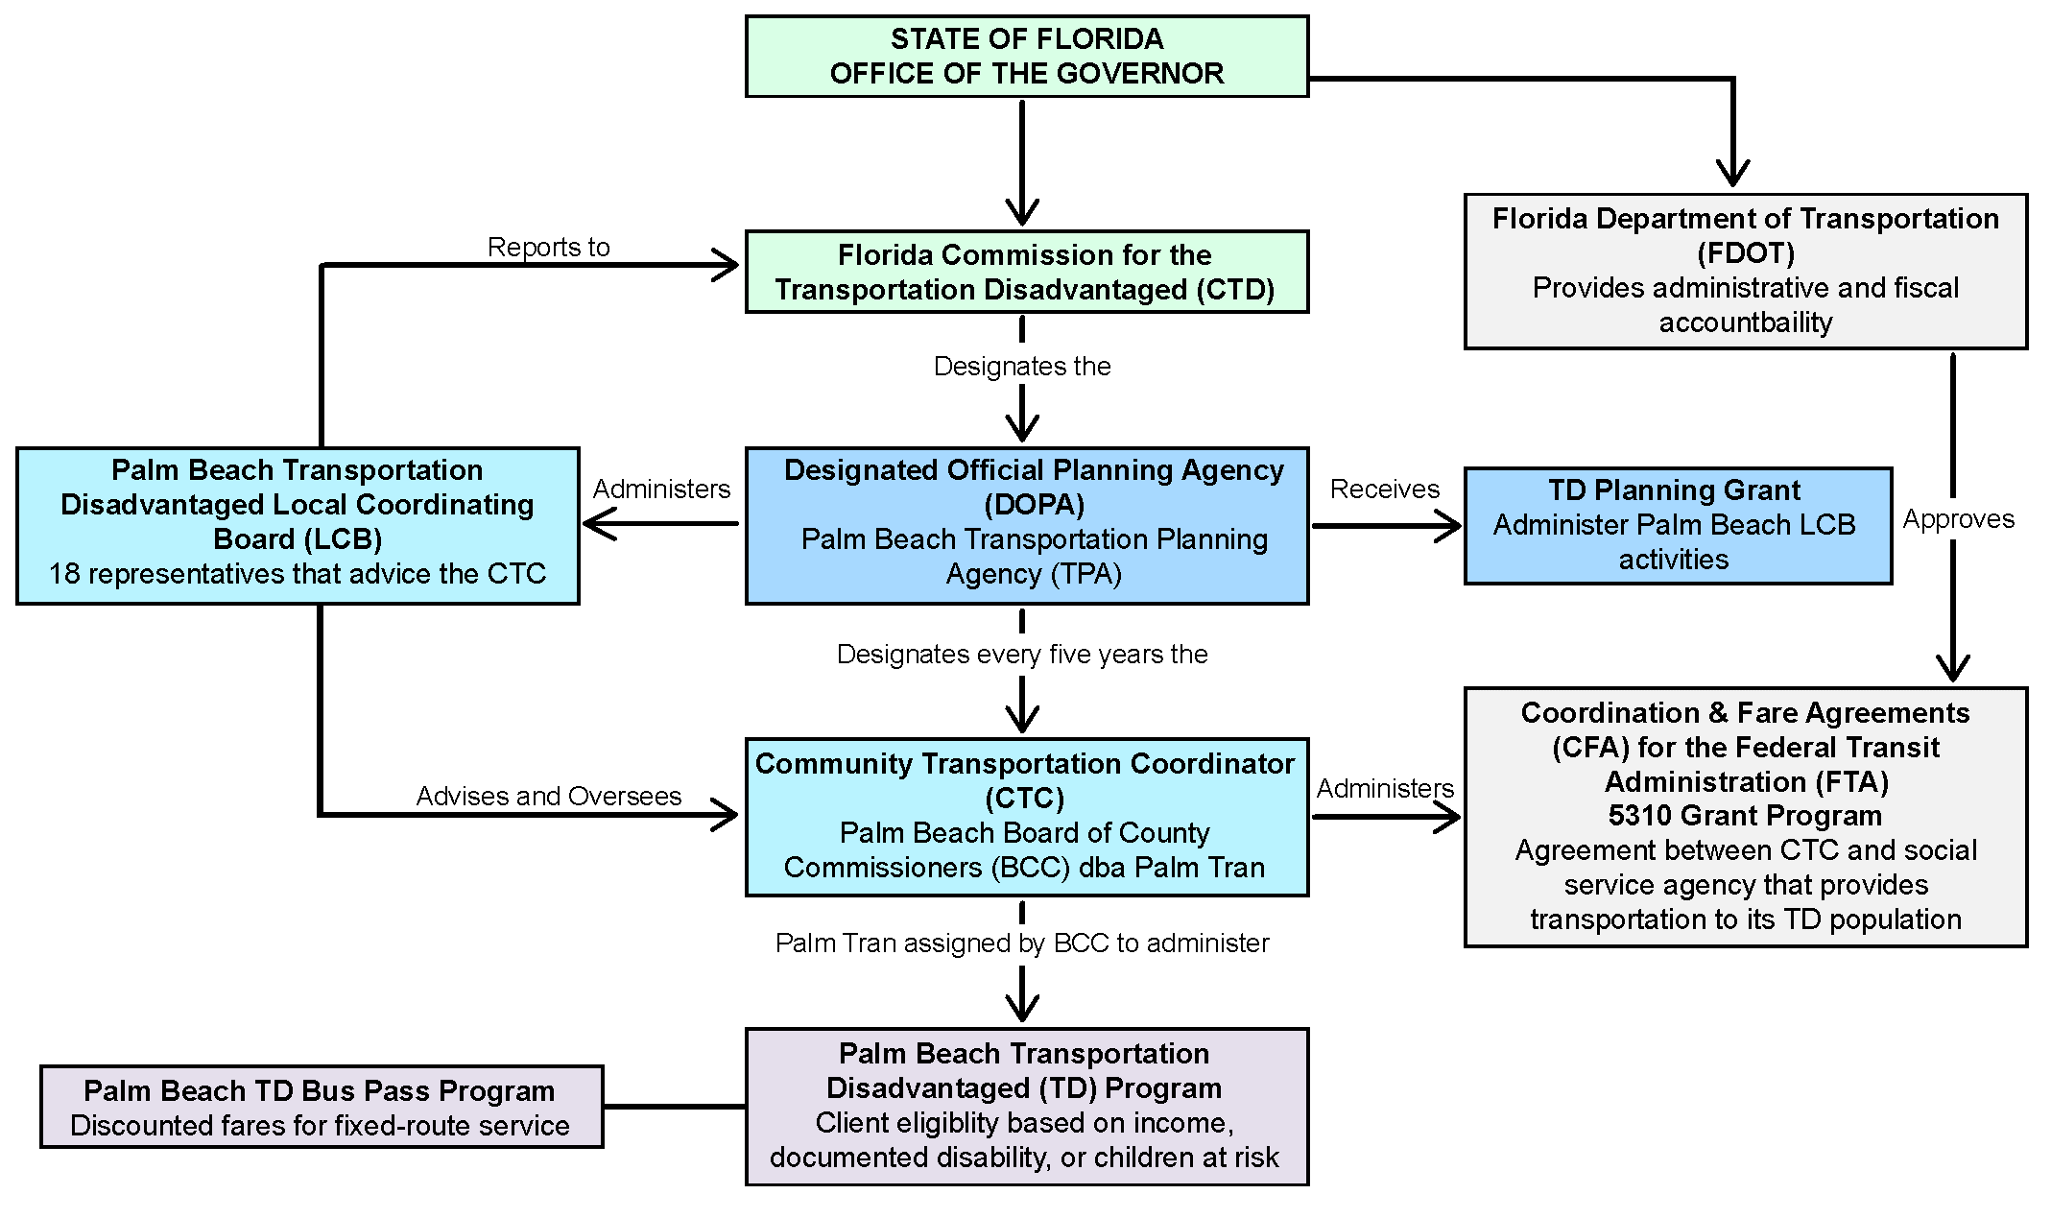
Transportation Disadvantaged Program
Notes:
CTD: Independent state agency created to accomplish the coordination of transportation services provided to the transportation disadvantaged population.
DOPA: The official body or agency designated by the CTD to fulfill the functions of transportation disadvantaged planning.
CTC: Transportation entity that ensures coordinated transportation services are provided to serve the transportation disadvantaged population.
LCB: The LCB is an advisory board, established by Florida Statutes to advise the CTD and CTC about local concerns and issues.

Slide 8
Transportation Disadvantaged Program
Notes:
CTD: Independent state agency created to accomplish the coordination of transportation services provided to the transportation disadvantaged population.
DOPA: The official body or agency designated by the CTD to fulfill the functions of transportation disadvantaged planning.
CTC: Transportation entity that ensures coordinated transportation services are provided to serve the transportation disadvantaged population.
LCB: The LCB is an advisory board, established by Florida Statutes to advise the CTD and CTC about local concerns and issues.

Slide 9
Designated Official Planning Agency (DOPA)
The official body or agency designated by the CTD to fulfill the functions of transportation disadvantaged planning.
In Palm Beach County, the DOPA is the Palm Beach TPA.

Slide 10
Transportation Disadvantaged Program

Slide 11
Community Transportation Coordinator (CTC)
Transportation entity that ensures coordinated transportation services are provided to serve the transportation disadvantaged population.
In Palm Beach County, the CTC is Palm Tran Connection.

Slide 12
Transportation Disadvantaged Program

Slide 13
Local Coordinating Board (LCB)
The LCB is an advisory board, established by Florida Statutes to advise the CTD and CTC about local concerns and issues.

Slide 14
Transportation Disadvantaged Program

Slide 15
Local Coordinating Board (LCB) Overview

Slide 16
LCB Overview
The Local Coordinating Board (LCB) is…
“an advisory entity in each designated service area composed of representatives appointed by the metropolitan planning organization or designated official planning agency, to provide assistance to the community transportation coordinator relative to the coordination of transportation services.” (F.S. 427.011)

Slide 17
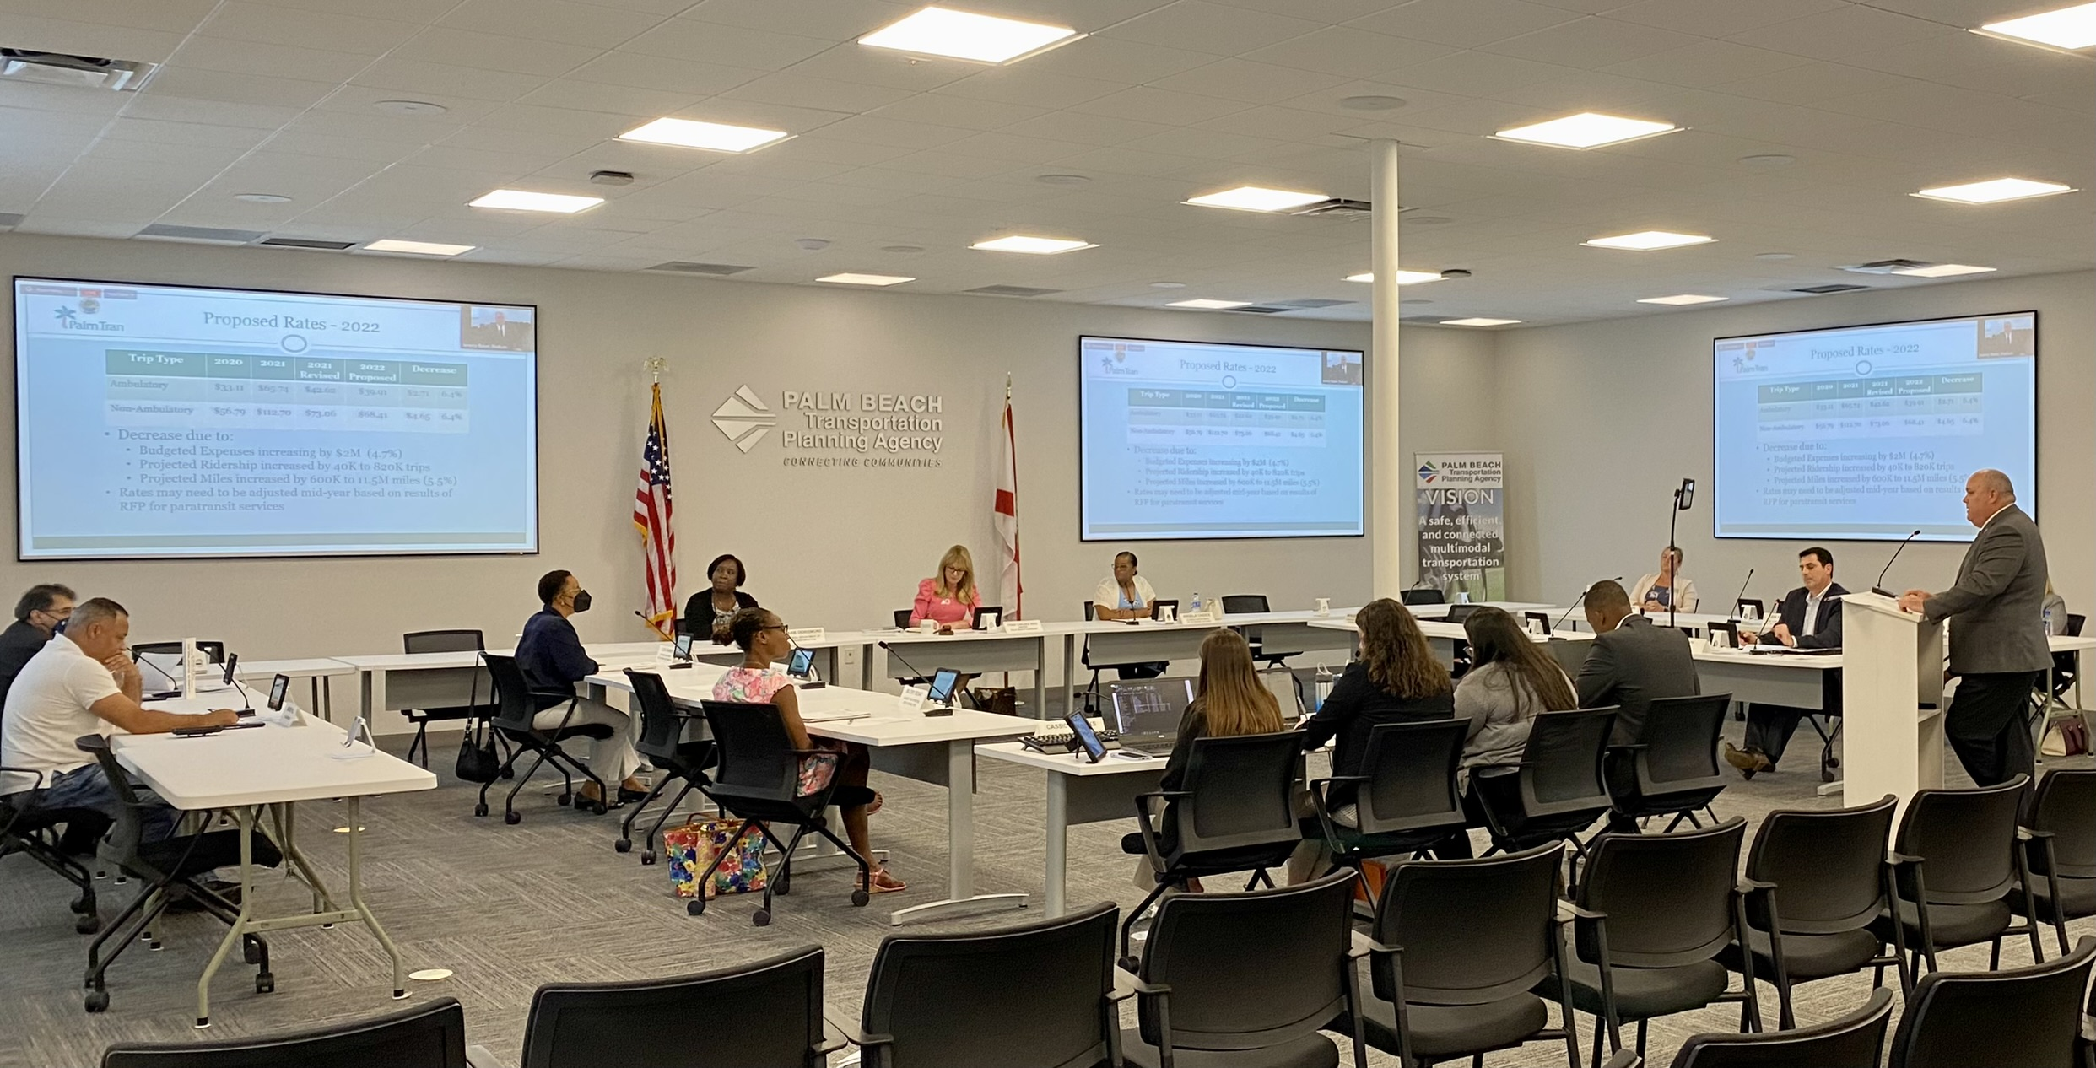
LCB Membership
18 Members
3 Vacancies
Membership rescinded after 3 consecutive unexcused absences.

Slide 18
LCB Membership
Chair
Citizen Advocate/User
Rep. for the Disabled
Rep. for the Elderly
Citizen Advocate
Florida Dept. of Veterans’ Affairs
PBC Community Action (Vacant)
School District of Palm Beach County
Florida Dept. of Transportation
Dept. of Children and Family Services
Agency for Persons with Disabilities
Florida Agency for Health Care Administration
Area Agency on Aging (Vacant)
Workforce Development Board
Local Medical Community
Florida Dept. of Vocational Rehabilitation
Private Transportation Industry (Vacant)
Representative for Children at Risk

Slide 19
LCB Duties

Slide 20
Overview of LCB Duties
Attend quarterly meetings
Review and adopt by-laws
Review and adopt Grievance Procedures
Appoint a Grievance Subcommittee
Review Annual Expenditure Report (AER)
Review and approve Annual Operating Report (AOR)
Review and approve TD Service Plan
CTC Evaluation
Annually appoint a Vice Chair

Slide 21
Timeline of LCB Duties FY 2023
TDSP Major Update
8/24/2022
Grievance Procedures
CTD Annual Workshop
8/24/2022
8/30/2022 8/31/2022
By-Laws
LCB Member Training
Public Hearing
8/24/2022
11/16/2022
2/22/2023
AER
AOR
CTC Evaluation Begins
CTC Evaluation Ends
8/24/2022
11/16/2022
2/22/2023
5/24/2023
Jul
1st Qtr. LCB Mtg.
2nd Qtr. LCB Mtg.
3rd Qtr. LCB Mtg.
4th Qtr. LCB Mtg.
8/24/2022
11/16/2022
2/22/2023
5/24/2023
2022
Jul
Aug
Sep
Oct
Nov
Dec
Jan
Feb
Mar
Apr
May
Jun
2023
07/01/2022
TDSP Major Update
08/24/2022
2/22/2023
CTC Evaluation
5/24/2023

Slide 22
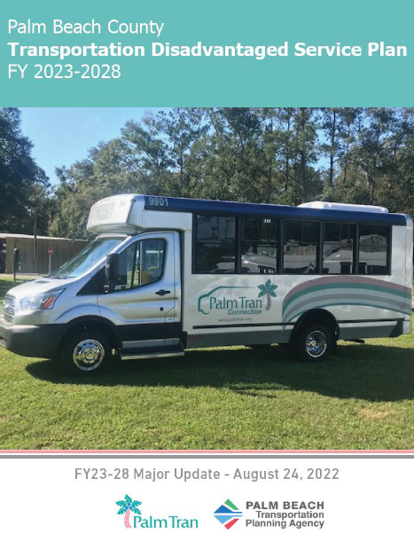
Transportation Disadvantaged Service Plan (TDSP)
Outlines TD services and service partners in Palm Beach County
Annual minor update
5 Year major updates

Slide 23
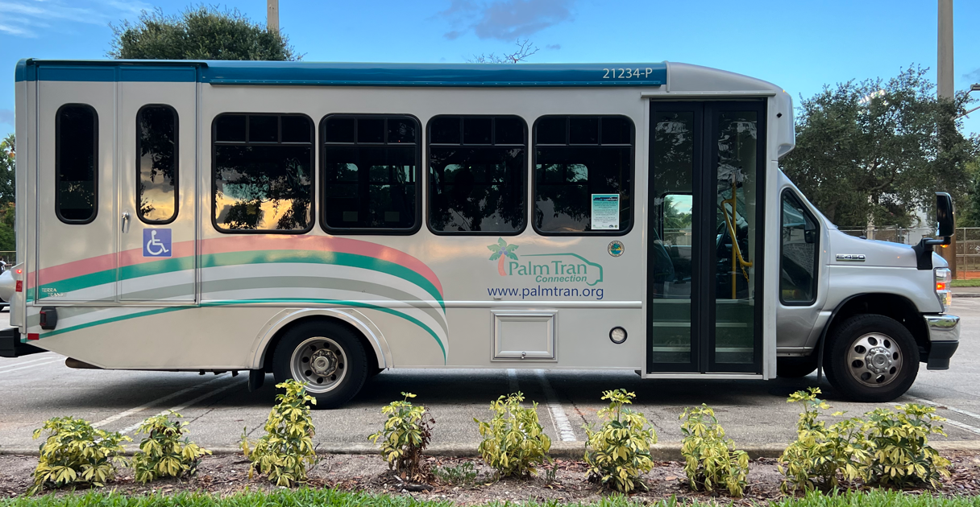
CTC Evaluation
LCB conducts annual evaluation of CTC’s performance
Criteria determined by the CTD
Evaluates Operations and Performance
Surveys riders/beneficiaries, purchasers of services, and contractors

Slide 24
LCB Administration

Slide 25
The LCB By-laws
Guides LCB Procedures and processes
Provide procedures and policies for fulfilling the requirements of Chapter 427, (F.S.), Rules 41-2, Florida Administrative Code
Set requirements for TD services and LCB operations
Notes:
The LCB is an advisory body that is established in section 427.0157, F.S., to advise the Commission and the CTC about local concerns and issues.
The purpose of the LCB is to identify local service needs and to provide information, advice, and direction to the Palm Beach County Community Transportation Coordinator (CTC) on the coordination of services to be provided to the transportation disadvantaged through the Florida Coordinated Transportation System.

Slide 26
LCB Attendance
Automatic recission of membership for 3 consecutive unexcused absences.
Excused Absence = Member must notify TPA of absence at least 1 business day prior to meeting

Slide 27
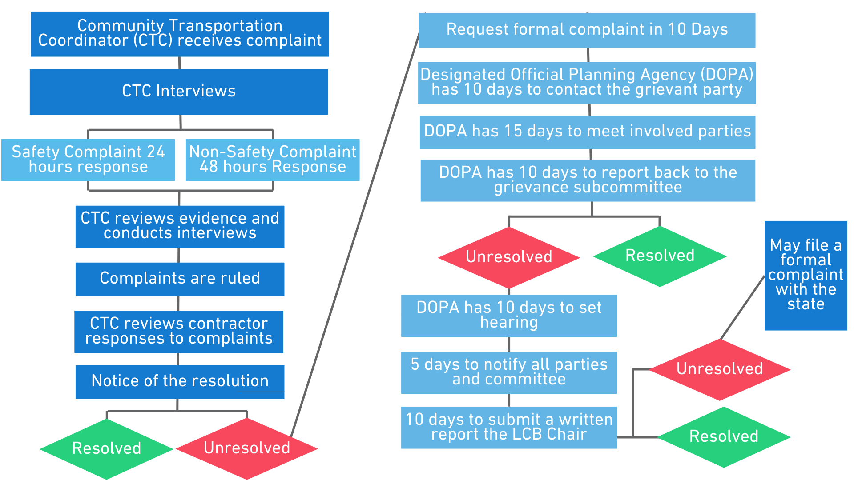
Grievance Procedures
Step 1: Complaint Filed
Step 2: Grievance Process
(if necessary)
Notes:
Note: Days = Business Days ex: DOPA has 10 BUSINESS days to respond

Slide 28
Grievance Procedures
The Grievance Subcommittee
Processes and investigates unresolved grievances
Makes recommendations to the LCB or to the Commission for improvement of service.
Does not possess adjudicative or determinative powers.

Slide 29
LCB Voting
“No member of a board or commission who is present at any meeting of the board or commission at which an official decision, ruling, or other official act is taken or adopted may abstain from voting.”

Slide 30
Timeline of LCB Duties FY 2023
TDSP Major Update
8/24/2022
Grievance Procedures
CTD Annual Workshop
8/24/2022
8/30/2022 8/31/2022
By-Laws
LCB Member Training
Public Hearing
8/24/2022
11/16/2022
2/22/2023
AER
AOR
CTC Evaluation Begins
CTC Evaluation Ends
8/24/2022
11/16/2022
2/22/2023
5/24/2023
Jul
1st Qtr. LCB Mtg.
2nd Qtr. LCB Mtg.
3rd Qtr. LCB Mtg.
4th Qtr. LCB Mtg.
8/24/2022
11/16/2022
2/22/2023
5/24/2023
2022
Jul
Aug
Sep
Oct
Nov
Dec
Jan
Feb
Mar
Apr
May
Jun
2023
07/01/2022
TDSP Major Update
08/24/2022
2/22/2023
CTC Evaluation
5/24/2023

Slide 31
Thank you!

