Slide 1
Annual Expenditure Report
November 16, 2022

Slide 2
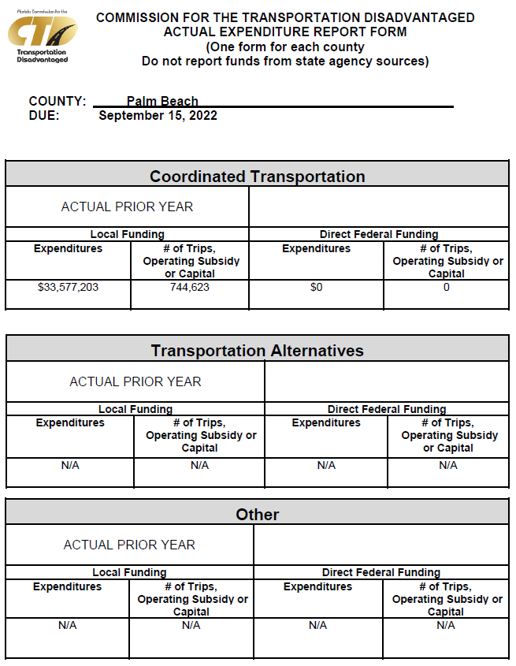
Annual Expenditure Report (AER)
The AER is a document that details all direct federal and local government funds spent on transportation disadvantaged trips
Does not include state funds, but does include local match money and number of trips
Numbers are for FY22

Slide 3
Coordinated Transportation
Local Funding |  | Direct Federal Funding
Expenditures | # of Trips, Operating Subsidy or Capital | Expenditures | # of Trips, Operating Subsidy or Capital
$33,577,203 | 744,623 | $0 | 0
Notes:
Coordinated Transportation - transportation purchased from the coordinated system.
Federal funding trips - This is a pro-rated number of trips based on the actual trips under the local funding

Slide 4
Transportation Alternatives & Other
Local Funding |  | Direct Federal Funding
Expenditures | # of Trips, Operating Subsidy or Capital | Expenditures | # of Trips, Operating Subsidy or Capital
N/A | N/A | N/A | N/A
Notes:
Transportation Alternatives - those specific services approved by rule to be acceptable transportation alternatives and as defined in Rule 41-2.015, Florida Administrative Code.
Other - items not included in coordinated transportation or transportation alternatives such as planning.

Slide 5
Questions?

