Slide 1
November 2022 Liaisons Report
LCB Liaison and Member 1 on 1: Members are encouraging to contact the LCB Liaison with comments and questions on agenda items.
Introduction Call: Please schedule time to meet with Mr. Gabriel. Through this meeting, he hopes to get to know you better and introduce himself. For more information visit: Calendly.com/GGabriel-1/15Min
TPA Governing Board Meeting: The next meeting will be held on December 15 at 9 a.m. both in-person and virtually. View agenda packet and meeting details at PalmBeachTPA.org/Board
Recap - 2022 CTD Conference and Training Workshop: The LCB Chair and Liaison participated in the 2022 Conference – Training Workshop and Expo from August 20 - 31.

Slide 2
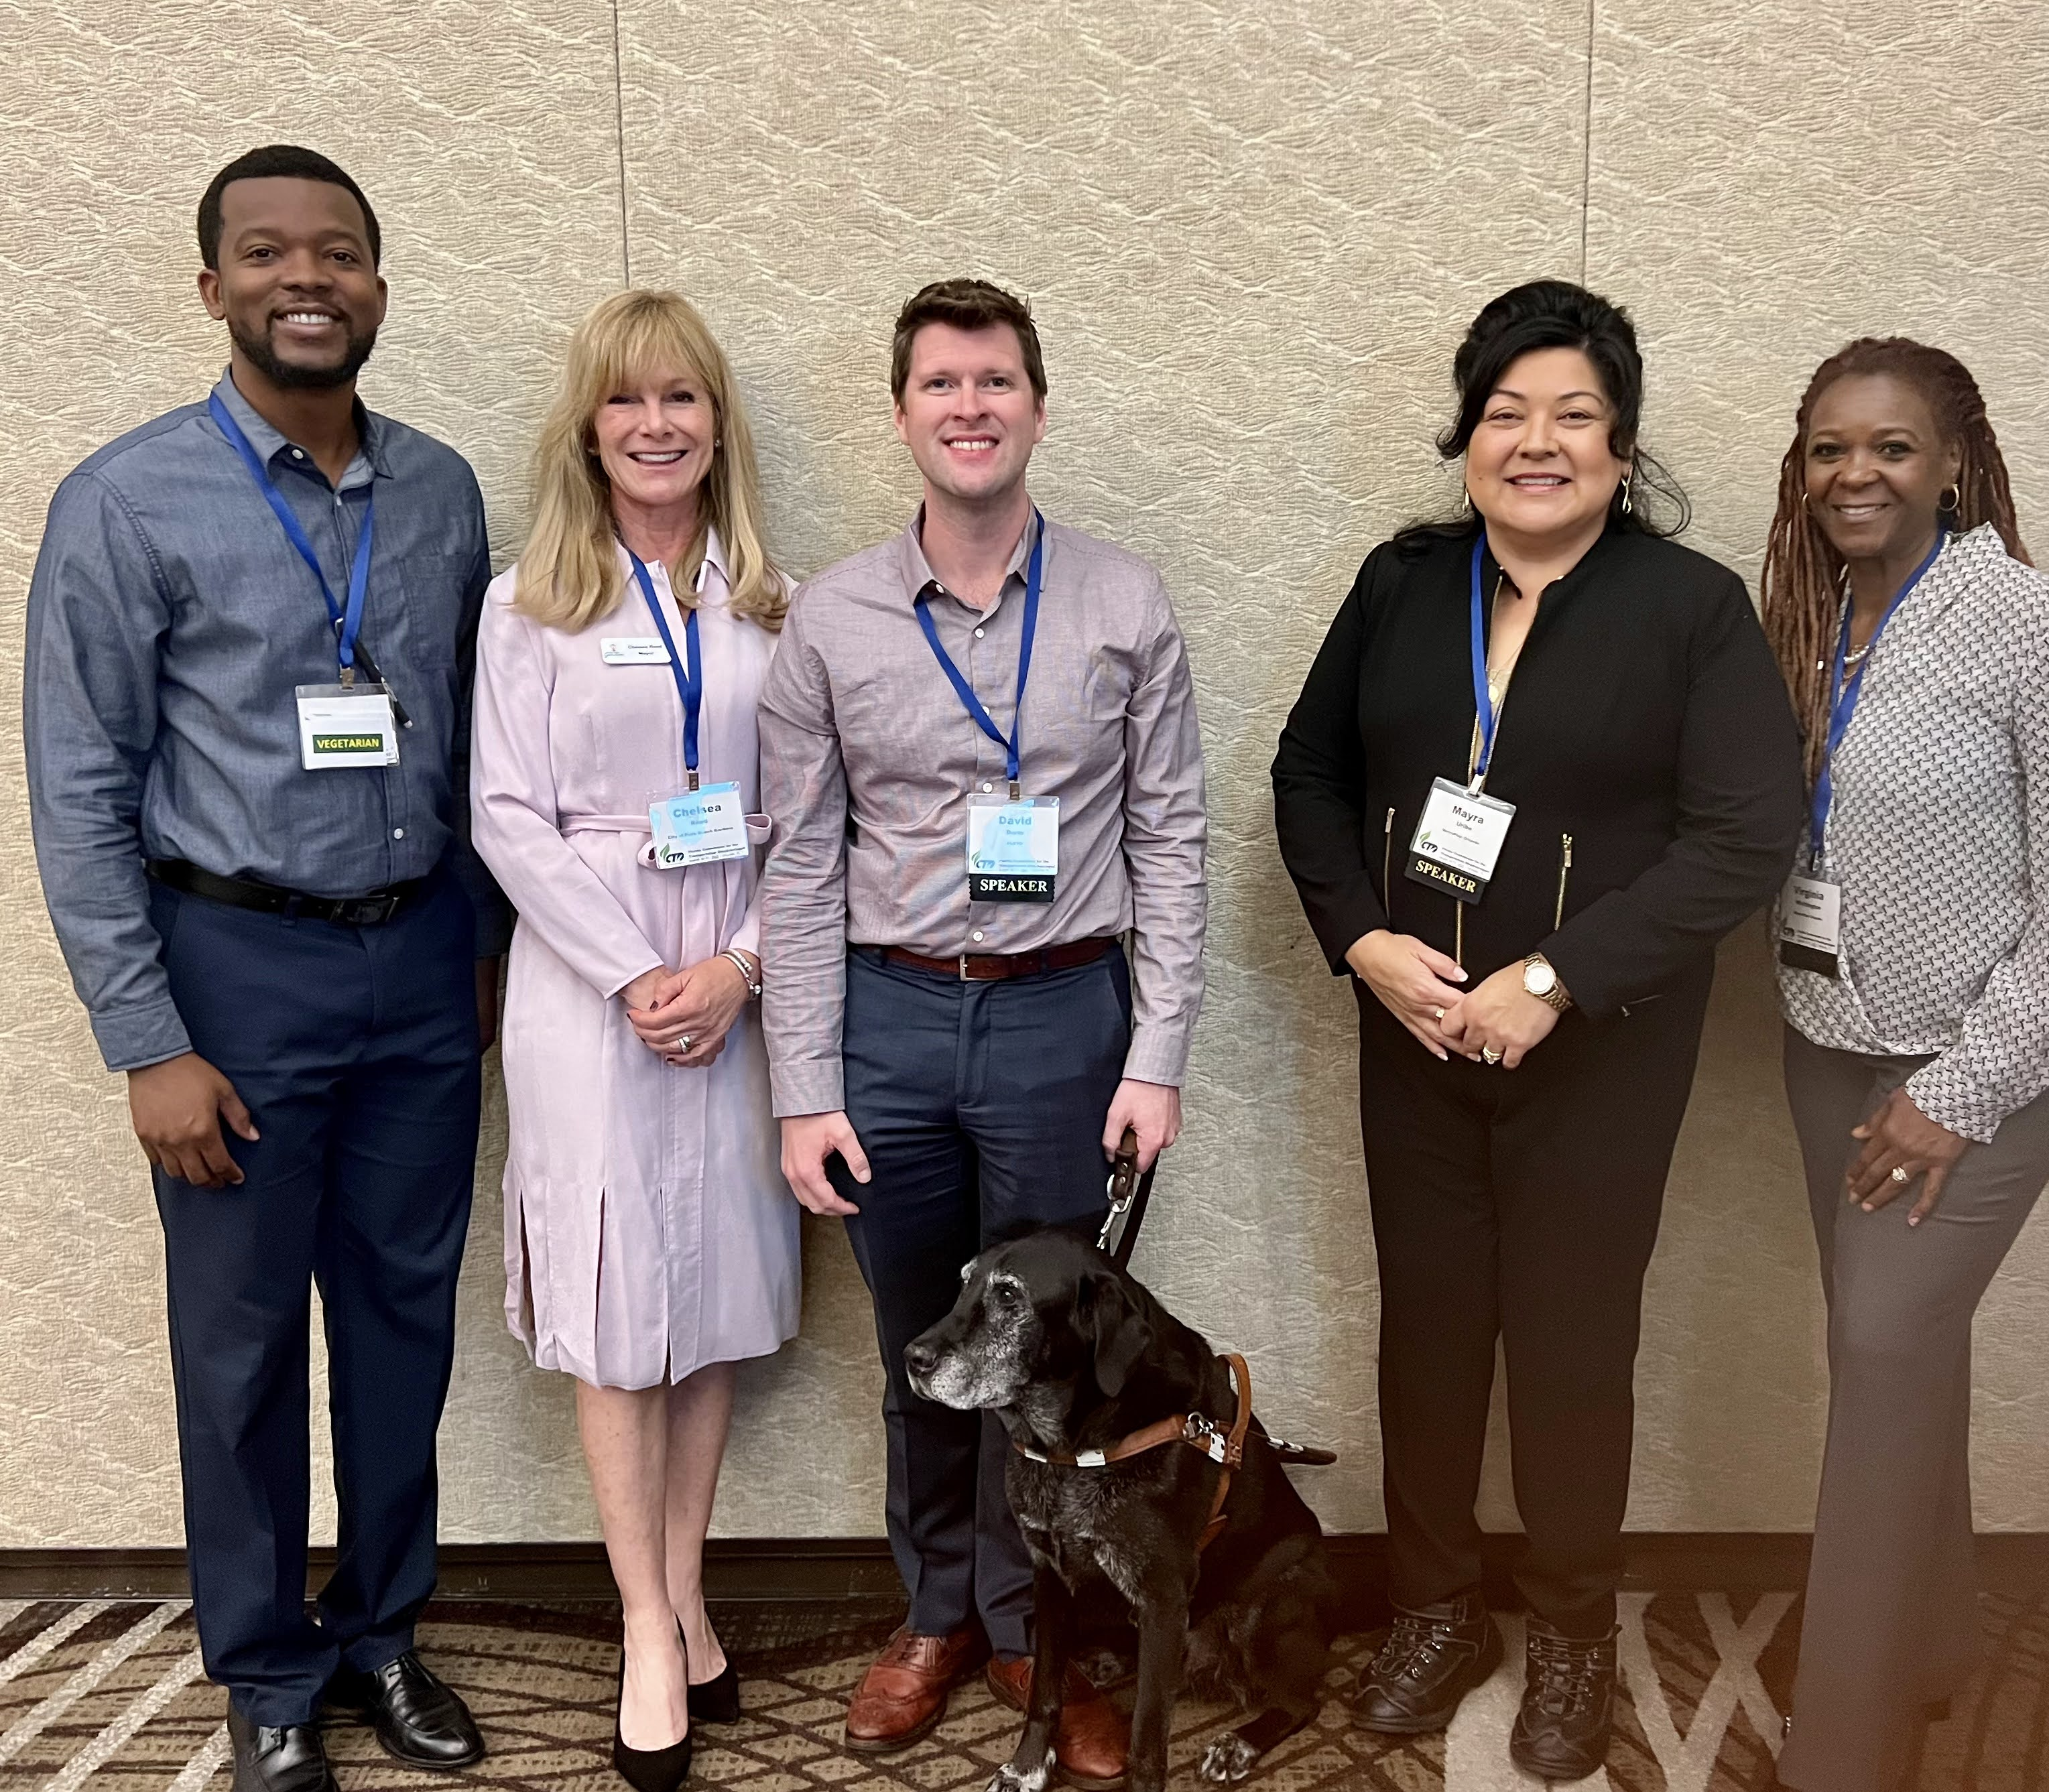
2022 CTD Conference Training Workshop & Expo
From left to right:
Grég Gabriel, Lead Planner – Transit Coordinator at Palm Beach Transportation Planning Agency
Mayor Chelsea Reed, City of Palm Beach Gardens
David Darm, Chief Executive Officer of Commission for the Transportation Disadvantaged
Commissioner Mayra Uribe, Orange County, District 3
Virginia Whittington, Director of Regional Partnerships at Metro Plan Orlando

Slide 3
TD Program Brochure
Notes:
The Palm Beach TPA, in collaboration with Palm Tran, updated the TD Program Brochure. There is clarification about the application process, eligibility criteria, fare breakdown, and trip reservation process. The brochure was provided in the Agenda Back Up for printing and distribution by interested agencies.

Slide 4
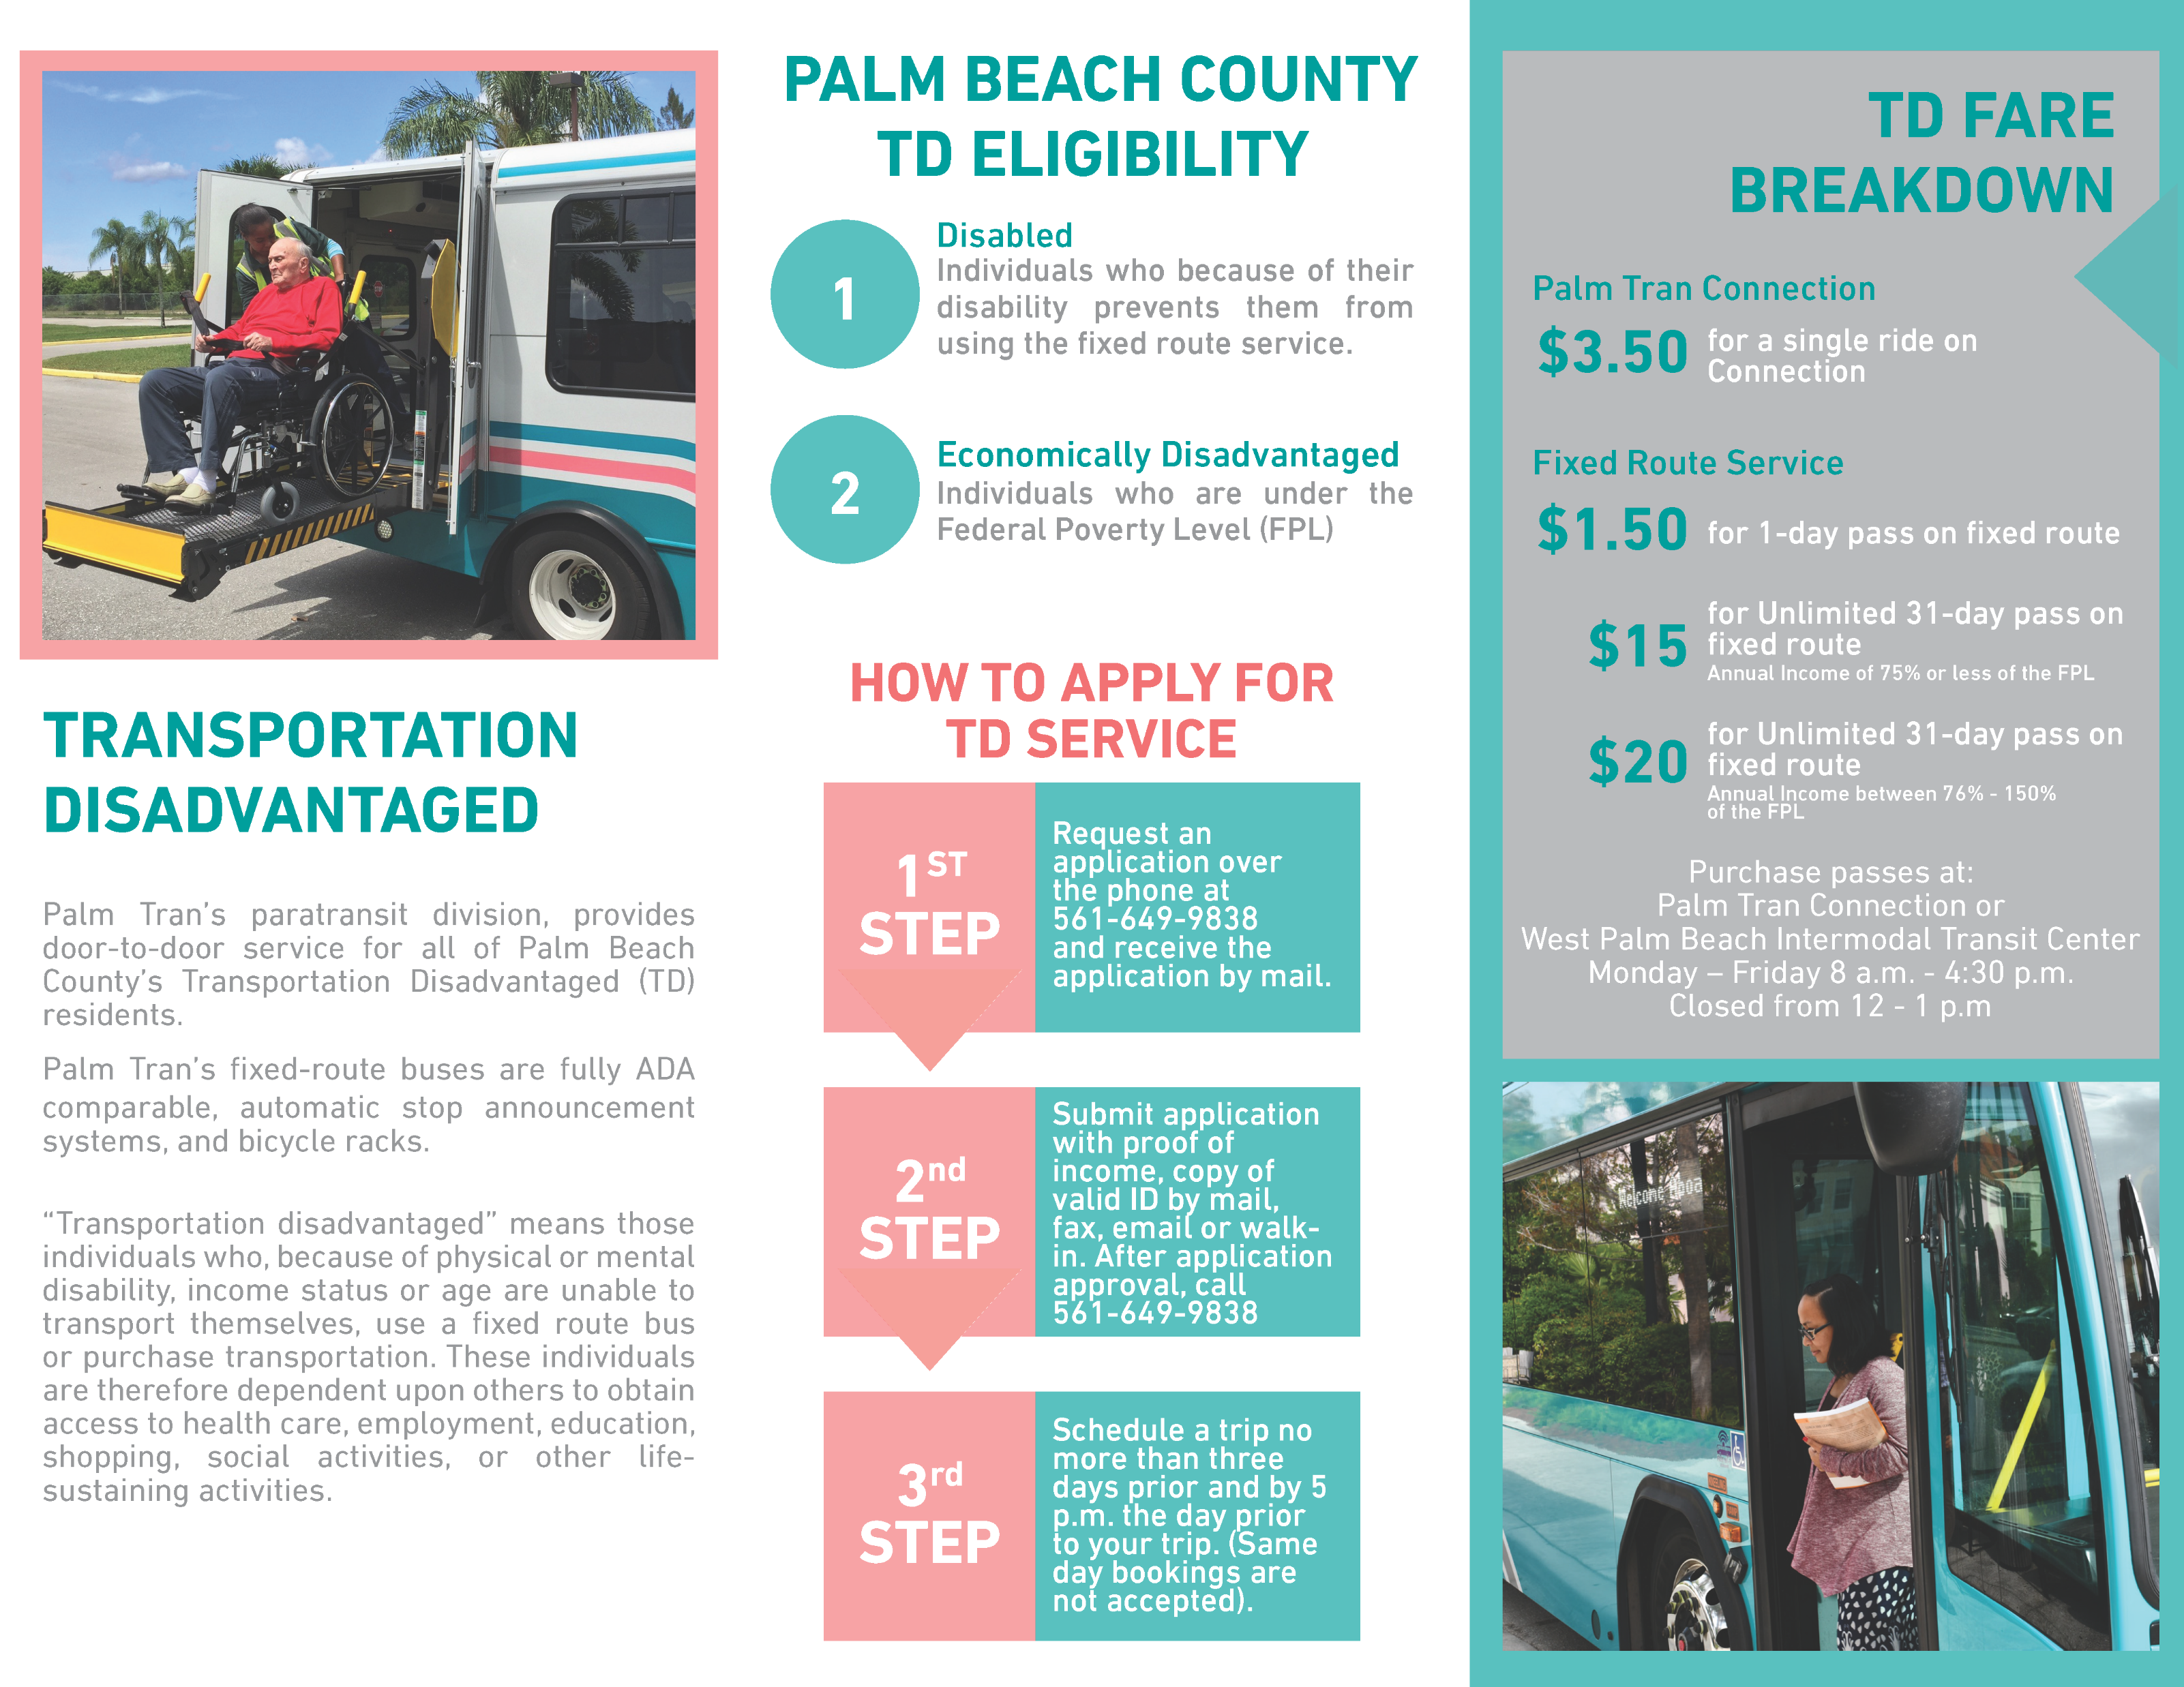
TD Program Brochure
Notes:
The Palm Beach TPA, in collaboration with Palm Tran, updated the TD Program Brochure. There is clarification about the application process, eligibility criteria, fare breakdown, and trip reservation process. The brochure was provided in the Agenda Back Up for printing and distribution by interested agencies.

Slide 5
Questions?

