Slide 1
Pedestrian & Bicycle Quarterly Fatal Crash Analysis
January 2022 – March 2022

Slide 2
Why Quarterly Reviews of Ped/Bike Fatalities?
Implements Vision Zero Action Plan
Ped/Bike crashes represent 29% of all traffic-related fatalities
Quarterly review promotes discussion and urgency
Accumulated data reveals trends and countermeasures
Notes:
Before jumping into the analysis, it is important to understand why we are conducting these quarterly reviews. So conducting these reviews Implements our culture action 3.1 from our 2021 vision zero action plan
Which we identified that ped/bike crashes represent
Additionally, quarterly reviews promotes
of providing reviews of fatal pedestrian and bicycle crash reports including observations and potential actions
For reference, there was a total of 67 fatalities including all road users (pedestrians, bicyclists, motor scooter riders, motorcyclists, and vehicle users).
Ped/bike crashes for this quarter represented 43% of all traffic-related fatalities
Over the last 5 years, ped/bike crashes represented 29% of all traffic-related fatalities (301/1024).
Which also providing the potential actions can encourage the roadway owner to take action.
And the accumulated data reveals trends and high-impact countermeasures

Slide 3
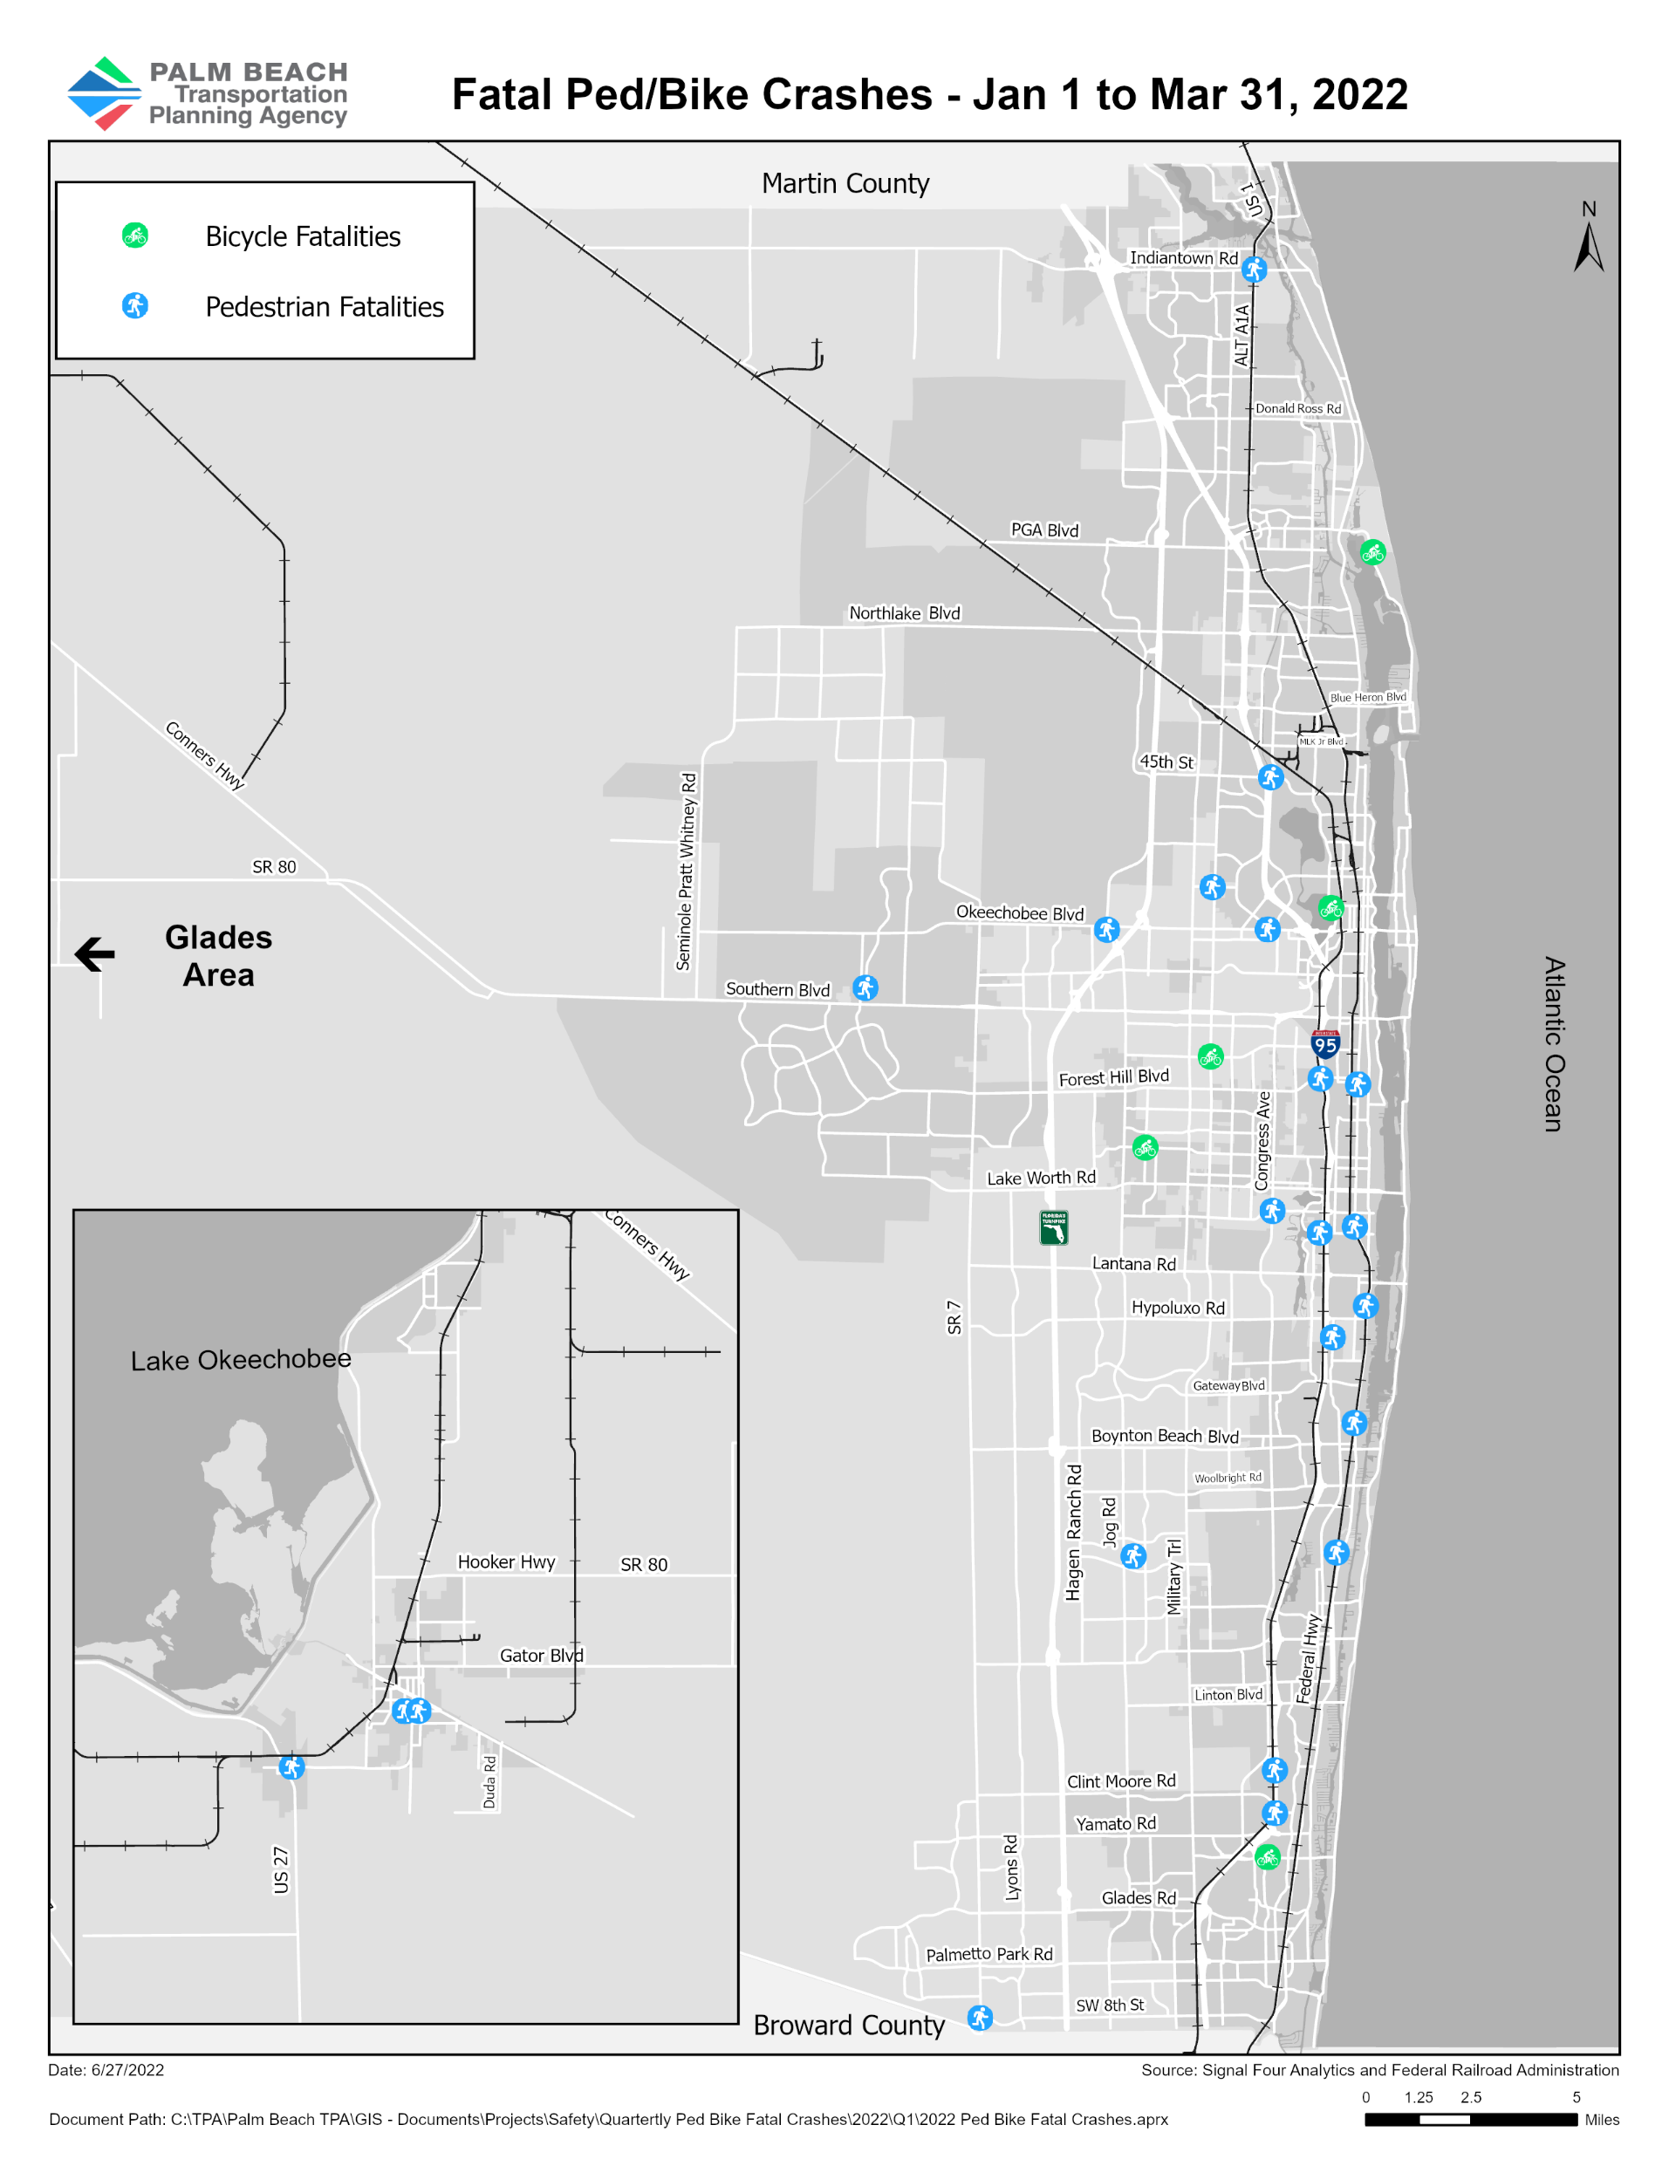
Summary (Jan. 1 - Mar. 31, 2022)
29 fatalities
5 fatal bicycle crashes
24 fatal pedestrian crashes
3 crashes involved alcohol
4 crashes caused by distracted driving
11 occurred during dark
Notes:
And 4 of the 24 pedestrian crashes occurred on a railroad track (3 on Florida East Coast railway (FEC) track and 1 on South Florida Railroad (SFRC) track)
Distracted driving includes the use of electronic communication so a cell phone, other electronic devices such as a dvd player, external distraction, texting, inattentive, or other type of inside distraction.

Slide 4
Proven Safety Countermeasures
Speed Management | Intersections | Pedestrian/Bicyclist
Appropriate Speed Limits | Roundabouts | Crosswalk Visibility Enhancements
Variable Speed Limits | Low-Cost Countermeasures | Roadway Reconfiguration
For more information: safety.fhwa.dot.gov/provencountermeasures/
Notes:
These are some of the Proven Safety Countermeasures Initiatives, which began in 2008, from the Florida Highway Administration as a collection of the countermeasures and strategies effective in reducing roadway fatalities and serious injuries on our Nation’s highways.
Speed management, roadway departure, intersections, pedestrian/bicyclist, and crosscutting
I won’t go into detail today for every countermeasure, but as an example, implementing intersection improvements, such as roundabouts can increase traffic flow and can reduce delay compared to other intersection alternatives.
Florida Highway Administration’s (FHWA’s) Proven Safety Countermeasures initiative (PSCi) is a collection of countermeasures and strategies effective in reducing roadway fatalities and serous injuries on our Nation’s highways.
In 2008, FHWA began promoting widespread use of certain infrastructure-oriented safety treatments and strategies that can offer significant, measurable impacts as part of any agency’s data-driven, systemic approach to improving safety. FHWA updated the PSCi in 2012, 2017, and 2021, reaching a current total of 28 PSCs. The cumulative list is diverse and broad, and practitioners can implement PSCs to successfully address a variety of crash types and focus areas like speed management, roadway departure, intersection, pedestrian, and bicyclist crashes to save lives and prevent serious injuries.
I won’t go into detail today for every countermeasure, but as an example, implementing intersection improvements, such as roundabouts can provide traffic flow and can reduce delay compared to other intersection alternatives.
Roundabouts are not only a safer type of intersection; they are also efficient in terms of keeping people moving. Even while calming traffic, they can reduce delay and queuing when compared to other intersection alternatives. Furthermore, the lower vehicular speeds and reduced conflict environment can create a more suitable environment for walking and bicycling. Roundabouts can be implemented in both urban and rural areas under a wide range of traffic conditions. They can replace signals, twoway stop controls, and all-way stop controls. Roundabouts are an effective option for managing speed and transitioning traffic from highspeed to low-speed environments, such as freeway interchange ramp terminals, and rural intersections along high-speed roads.

Slide 5
Next Steps
Incorporate feedback from committees and stakeholders
Recommend countermeasures where feasible
Align the TPA’s process with FDOT’s fatal crash report efforts
Notes:
incorporate the feedback we receive from the committees, the board, and stakeholders
(which in this case, FDOT, PBC, Boca Raton, city of Belle Glade, West Palm Beach, Lake Worth, and the private roadway owners).
FDOT has a program to review all fatalities that occur on the State Highway System anywhere in the 5-county District, called the Highway Safety Improvement Program (HSIP).
Within the Highway Safety Improvement Program, FDOT also has project and countermeasure evalutions which recommends using the Empirical Bayes (EB)

Slide 6
Questions?
Notes:
And that is a wrap on my presentation, I can take any questions at this time.
Signal Four Analytics is an interactive web-based platform from the FDOT, which is maintained by the University of Florida GeoPlan Center in partnership with the Traffic Records Coordinating Committee (TRCC). The TRCC manages federal funds and aims to improve traffic information systems in the state. Access to the Signal Four Dashboard is open to the public, and its downloading capabilities to government agencies.
FDOT has a program to review all fatalities that occur on the State Highway System anywhere in the 5-county District, called the Highway Safety Improvement Program (HSIP).

