Slide 1
Laura Schultze, M.S.
Manager for Curriculum, Instruction, and Assessment
School District of Palm Beach County
Department of Exceptional Education

Slide 2
Specialized curriculum for students with disabilities
Statewide, standardized assessments for students with disabilities
Supervise ESE Department Teams for:
Secondary Transition
Reading
Access Points

Slide 3
SWD who defer receipt of HS diploma to develop increased community independence and work skills
SWD who take courses to develop career and independence skills before HS graduation
District SWD develop academic and life skills to prepare for their future

Slide 4
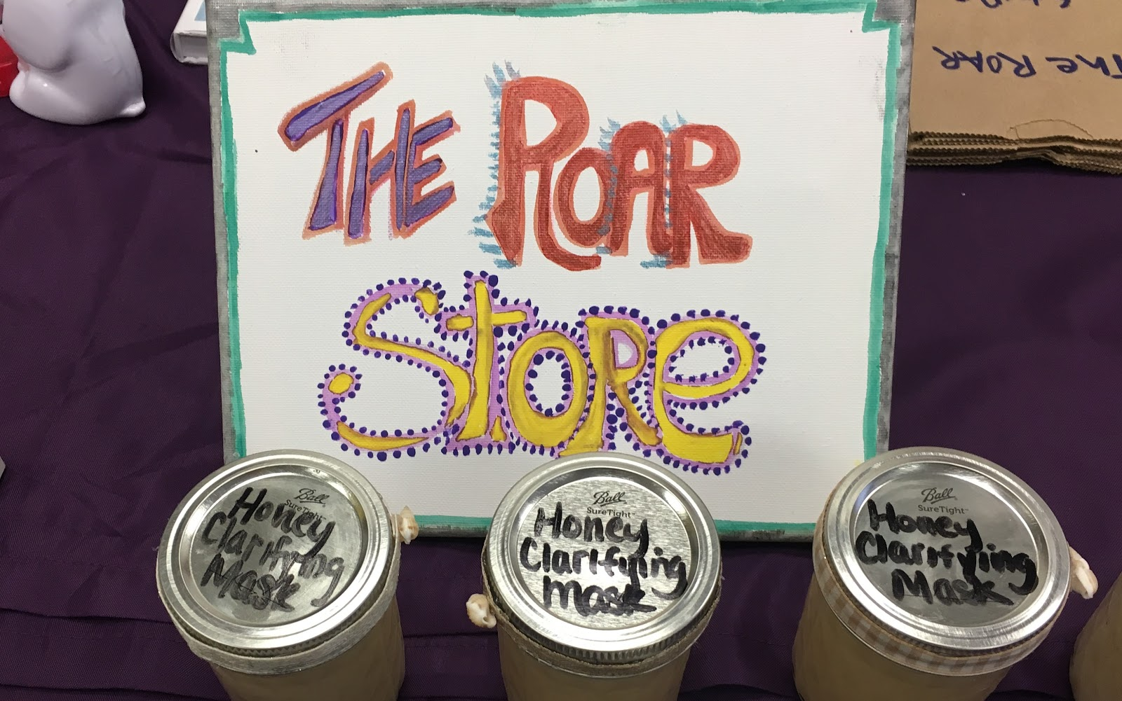
Work and Community Independence Skills

Slide 5
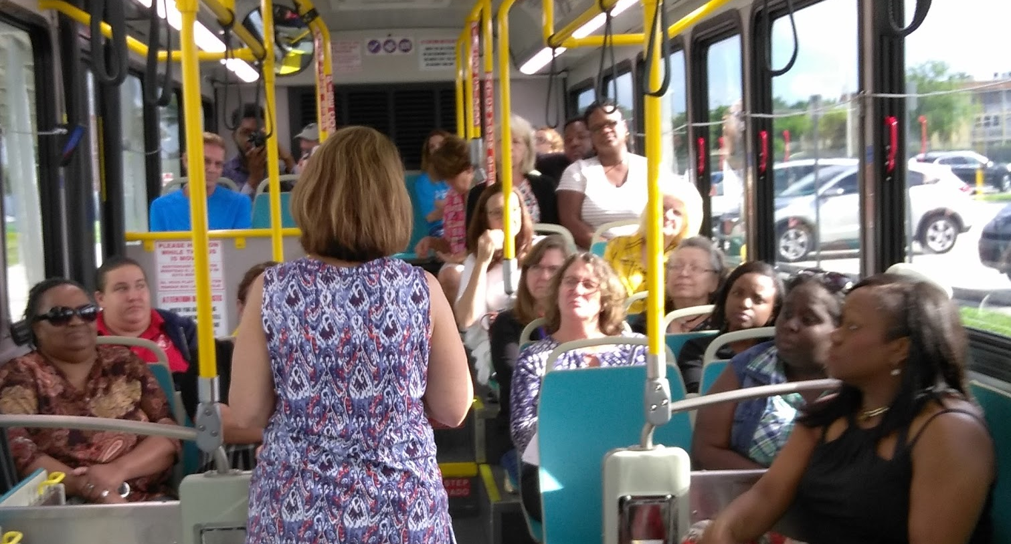
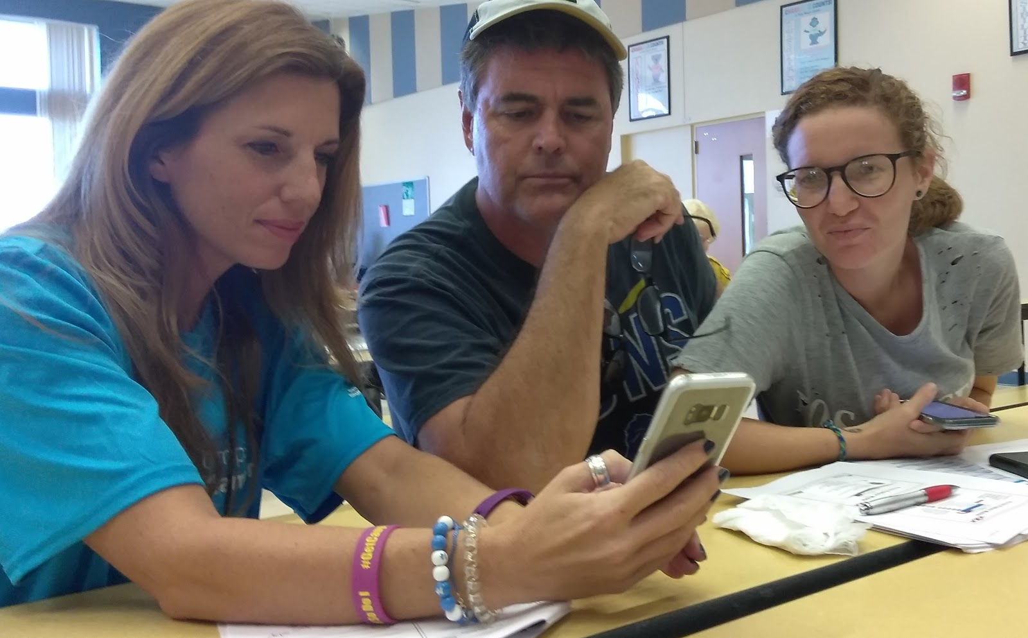
Travel Trainer Training
Builds Student Travel Independence

