Slide 1
Palm Tran Transit Signal Priority (TSP) Update
TPA Governing Board
July 21, 2022

Slide 2
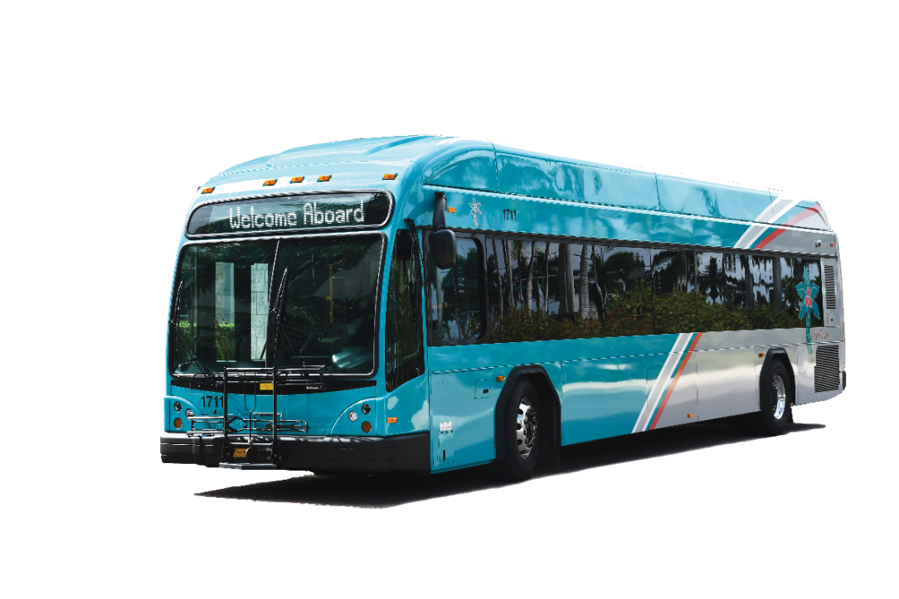
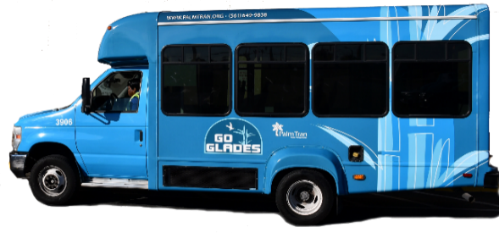
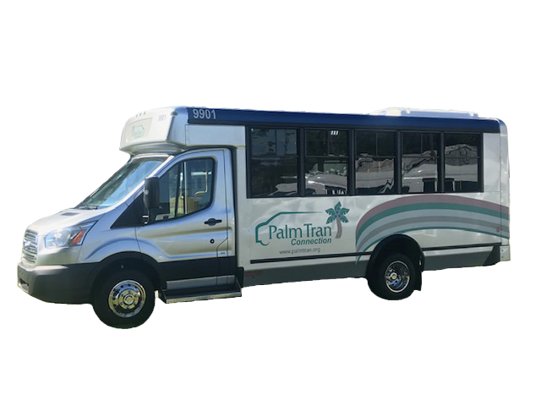
Ridership Update
Fixed Route
MOD
Paratransit
Ridership is trending positively year-over-year

Slide 3
Ridership Update
Fixed Route
MOD
Paratransit
System-wide ridership is slowly recovering

Slide 4
Transit Signal Priority Overview
Definition
Special treatment to transit vehicles at signalized intersections
Benefits (TCRP Synthesis 149)
Reduces travel times (San Francisco – up to 7%)
Reduces intersection delays (San Francisco – up to 50%)
Improves schedule adherence (King County – up to 30%)
Fewer buses needed (Rhode Island – 13 to 12 on R-Line)
Possible schedule adherence improvement – 80% to >90%
Notes:
King County Metro found reductions in intersection delay of between 2% and 14% for its deployment group focusing on travel time reductions, and 30% improvements in headway adherence for its deployment group focusing on schedule adherence.
Rhode Island Public Transit Authority (RIPTA) - When TSP was initially deployed on the R-Line, there were 13 buses running the R-Line. Twelve months after TSP deployment, RIPTA was able to remove one bus (a reduction from 13 to 12 buses) and still maintain the same bus frequency and headways. RIPTA also reported an increase in on-time performance.
San Francisco Municipal Transportation Agency (SFMTA) – Qualitatively, SFMTA has seen modest improvements in bus travel times, bus travel time variability, and delay at intersections with the current TSP system. The current GPS-based system dates only to 2013, and SFMTA is still working on quantifying benefits. Travel time savings of 7% and intersection approach delay reductions of up to 50% have been observed on select segments.
The San Diego Metropolitan Transit System (MTS) - Qualitatively, MTS has seen modest improvements in bus travel times, schedule adherence, headway adherence, bus travel time variability, and headway variability with TSP, as well as significant improvements to delay at intersections. The best results have been observed on route 225, which has a long stretch with dedicated lanes and TSP, producing faster trips and shorter dwell times. MTS notes that the general public is impressed by the technology, viewing TSP as “futuristic.” MTS believes that the perception of speed helps to attract choice riders.

Slide 5
Priority vs Preemption
 | Transit Priority | Fire Rescue Preemption
Extends green lights | ✓
Interrupts signal timing |  | ✓
Corridor application | ✓
County-wide application |  | ✓
Cloud-based technology | ✓ | ✓
Vendor availability | ✓ | ✓

Slide 6
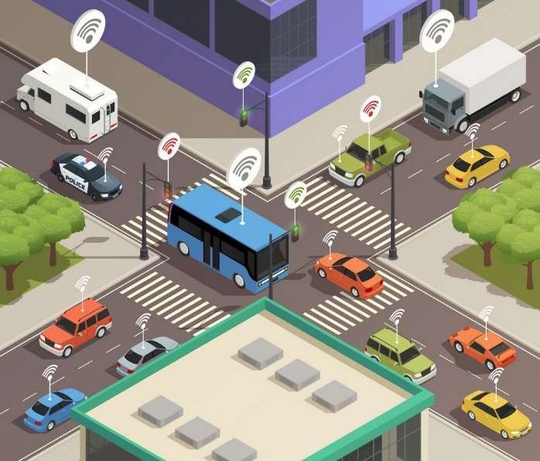
TPA-Funded Corridors
US 1
Palmetto Park Rd to Northlake Blvd
$2M with construction in FY23
Route 1 with 20-minute headway
Okeechobee Blvd
SR 7 to US 1 / SR 7 from Forest Hill Blvd to Okeechobee Blvd
$1M with capital available in FY24
Route 43 with 20-minute headway
Notes:
A passive priority strategy seeks to favor roads with significant transit use in the area-wide traffic signal timing scheme. Timing coordinated signals at the average bus speed instead of the average vehicle speed can also favor transit vehicles.
By contrast, an active priority strategy involves detecting the presence of a transit vehicle and, depending on the system logic and the traffic situation then existing, giving the transit vehicle special treatment. The system can give an early green signal or hold a green signal that is already displaying. An active system must be able to both detect the presence of a bus and predict its arrival time at the intersection.

Slide 7
Study Goals
Identify stakeholders for engagement and coordination
Methodology for screening signalized intersections
Framework for concept of operations
Update minimum technical requirements
Develop request for proposal

Slide 8
Existing Technologies
Palm Tran
159 on-board units for bus-to-bus communications
Near real-time vehicle position updates every 30 seconds
Palm Beach County Traffic
Discontinued emergency vehicle preemption system
Signal timing optimization performed monthly
Adaptive signal priority

Slide 9
Existing Technologies
Palm Beach County Fire Rescue
On-board units communicate every second during calls
No dynamic routing or rerouting capability
Boca Raton Traffic Engineering
No existing transit signal priority
Emergency vehicle preemption system
Signal timing optimization performed weekly
Adaptive signal priority

Slide 10
Priority Application
Passive Priority
Signal timing optimization
Active Priority
Schedule based – headways greater than 10 minutes
Trigger – 3 minutes or greater than scheduled arrival time
Emergency vehicle preemption
Headway adherence – less than 10 minutes (future)
Onboard ridership (future)
Notes:
A passive priority strategy seeks to favor roads with significant transit use in the area-wide traffic signal timing scheme. Timing coordinated signals at the average bus speed instead of the average vehicle speed can also favor transit vehicles.
By contrast, an active priority strategy involves detecting the presence of a transit vehicle and, depending on the system logic and the traffic situation then existing, giving the transit vehicle special treatment. The system can give an early green signal or hold a green signal that is already displaying. An active system must be able to both detect the presence of a bus and predict its arrival time at the intersection.

Slide 11
Functional Requirements
Intelligent priority control & preemption-intersection interface
Advanced traffic management system
Traffic controller
Preemption/priority control equipment
Intelligent priority control and preemption application-vehicle interface
Accept TSP and emergency vehicle preemption requests
Accept vehicle data
Notes:
A passive priority strategy seeks to favor roads with significant transit use in the area-wide traffic signal timing scheme. Timing coordinated signals at the average bus speed instead of the average vehicle speed can also favor transit vehicles.
By contrast, an active priority strategy involves detecting the presence of a transit vehicle and, depending on the system logic and the traffic situation then existing, giving the transit vehicle special treatment. The system can give an early green signal or hold a green signal that is already displaying. An active system must be able to both detect the presence of a bus and predict its arrival time at the intersection.

Slide 12
Next Steps & Target Timeline
Ongoing coordination with Palm Beach TPA/FDOT D4
Finalize request for proposal – July to August 2022
Amend TIP to increase allocated capital cost – October 2022
Technology Pilot – November to December 2022
Issue solicitation – January to February 2023

Slide 13
Palm Tran Transit Signal Priority (TSP) Update
Thank you for listening.
Questions?

