Slide 1
Palm Beach TPA Interim Director’s Report
May 3, 2022

Slide 2
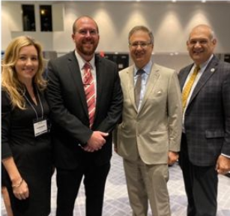
Interim Director’s Report
Staff Update: Lead Planner – Transit Coordinator
June 2 Palm Beach County Economic Summit: Transportation & Housing Recap
June 3 Miami SMART Trends Transportation Summit Recap
June 16 Growth & Infrastructure BDB Task Force Roundtable: BDB.org/Events
July 6-8 Floridians for Better Transportation (Boca Raton): BetterTransportation.org
June 13-14 Road User Fee Charging Conference (Miami): RoadUserChargingConferenceUSA.com
September 29-30 Peer Exchange with Austin, TX – Update

Slide 3
PalmBeachTPA.org
Valerie Neilson, AICP
INTERIM EXECUTIVE DIRECTOR
VNeilson@PalmBeachTPA.org

