Slide 1
Draft Fiscal Year 2023 Strategic Plan
July 2022

Slide 2
FY 2022 Annual Report Highlights
Fiscal Year
2022
Annual
Report
July 1, 2021 – June 30, 2022

Slide 3
FY 2022 Highlights – Administer the Agency and Report Card
Fiscal Year
2022
Annual
Report
July 1, 2021 – June 30, 2022

Slide 4
FY 2022 Highlights
Fiscal Year
2022
Annual
Report
July 1, 2021 – June 30, 2022
Reserved for Closed Captions

Slide 5
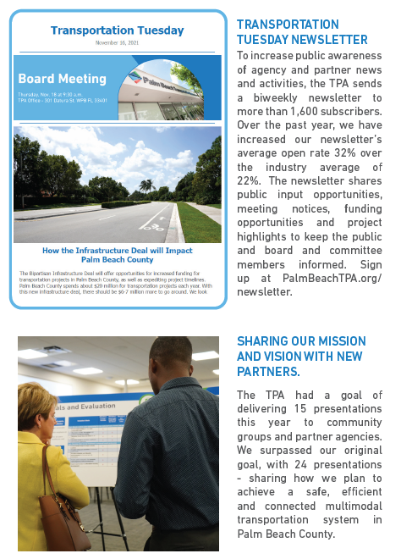
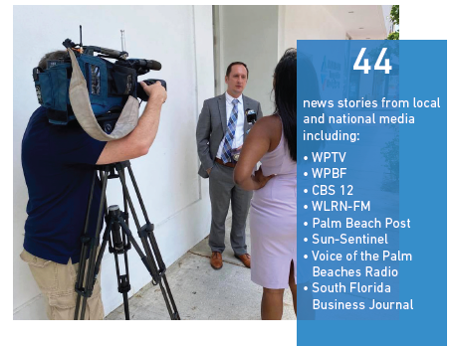
FY 2022 Highlights – Engage the Public

Slide 6
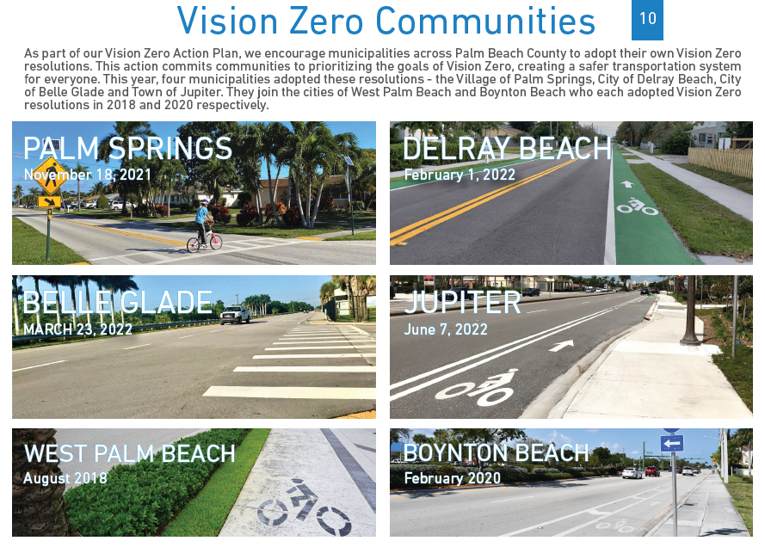
FY 2022 Highlights – Plan the System
Fiscal Year
2022
Annual
Report
July 1, 2021 – June 30, 2022

Slide 7
FY 2022 Highlights – Prioritize Funding
Fiscal Year
2022
Annual
Report
July 1, 2021 – June 30, 2022

Slide 8
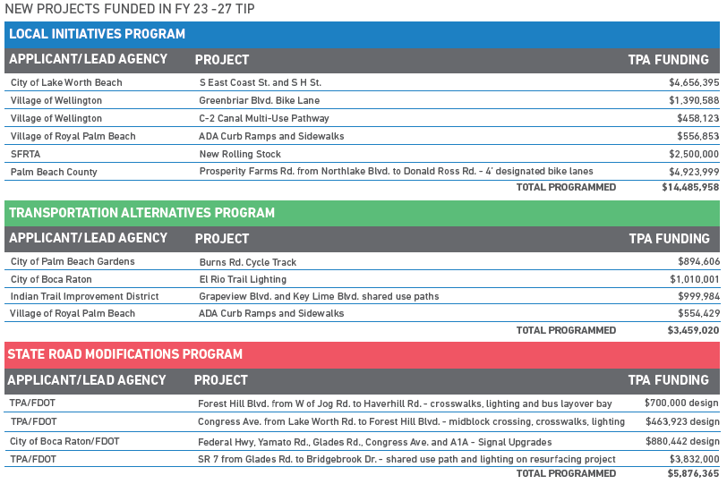
FY 2022 Highlights – Implement Projects
Fiscal Year
2022
Annual
Report
July 1, 2021 – June 30, 2022

Slide 9
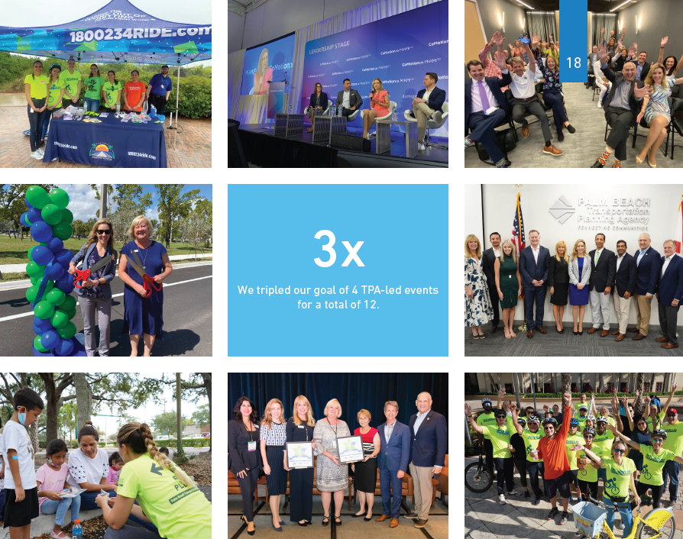
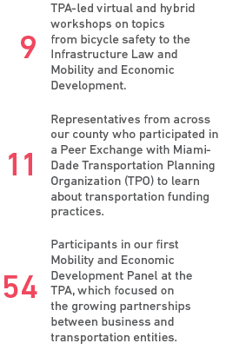
FY 2022 Highlights – Collaborate with Partners
Fiscal Year
2022
Annual
Report
July 1, 2021 – June 30, 2022

Slide 10
Draft FY 23 Strategic Plan

Slide 11
Executive Committee Review
Executive Committee Members
Chair Robert S. Weinroth Palm Beach County Mayor
Vice Chair Chelsea S. Reed Palm Beach Gardens Mayor
Maria Marino Palm Beach County Commissioner
Michael Napoleone Wellington Councilman
Joel Flores Greenacres Mayor
Met on June 6, 2022 to recommend updates to the FY 23 Strategic Plan
Draft presented to committees

Slide 12
Engage the Public

Slide 13
Plan the System

Slide 14
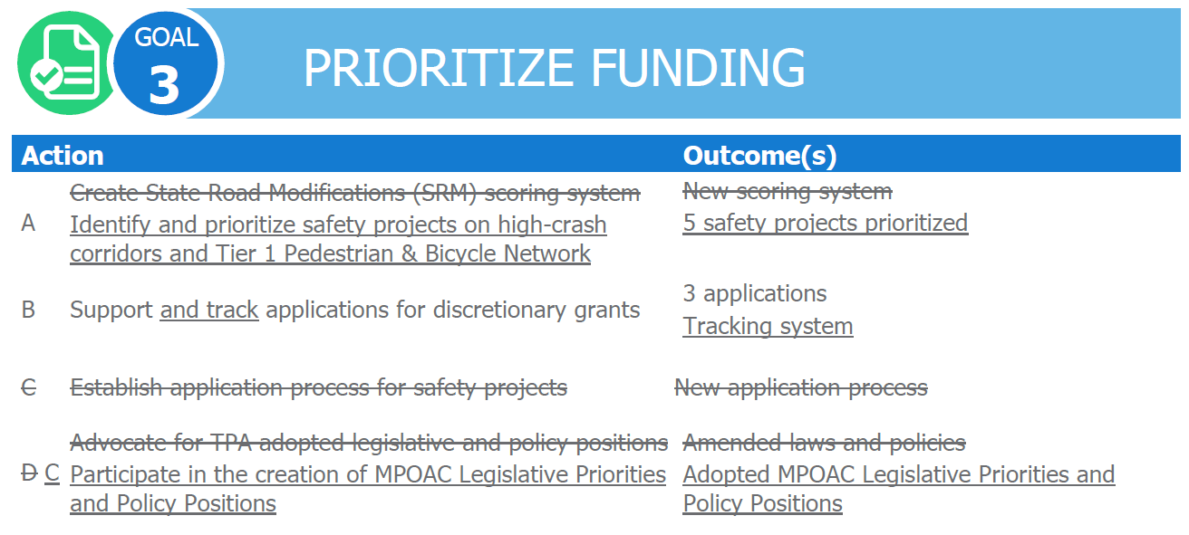
Prioritize Funding

Slide 15
Implement Projects

Slide 16
Collaborate with Partners
Notes:
Keep “local governments” in outcome for new 5.B?

Slide 17
Administer the Agency

Slide 18
Motion to Approve the FY 23 Strategic Plan

