Slide 1
List of Priority Projects
Fiscal Year (FY) 2024-2028
TPA Governing Board – July 2022
Notes:
Introduce TIP document – First Reading of TIP
1. This is a draft of the final that will be presented for approval next month in June
2. The TIP document covers 5 years from 2023-2027
3. List all project programed by FDOT in their work program as well as other regional and local projects

Slide 2
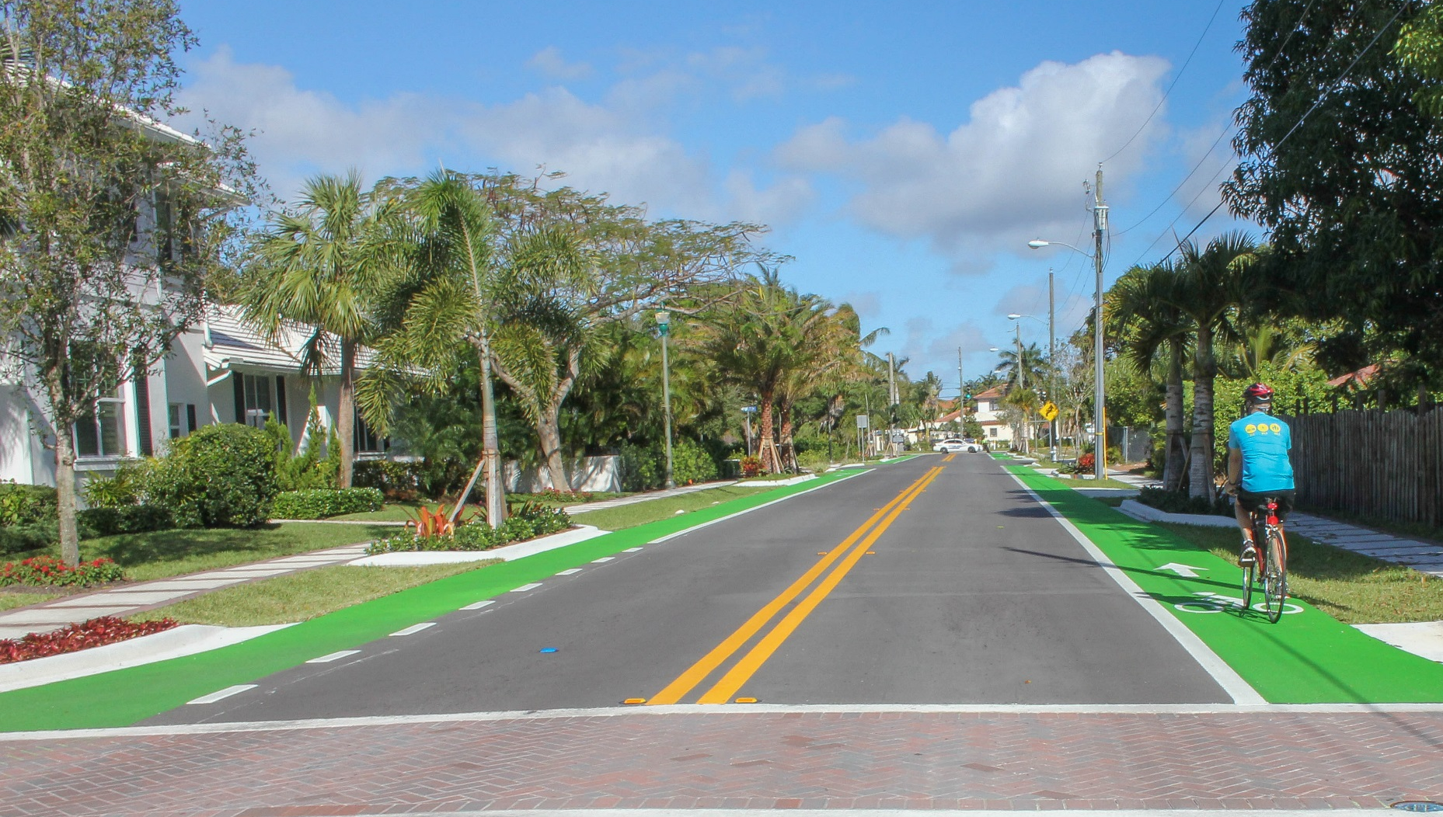
Mission Statement
MISSION
To collaboratively plan, prioritize, and fund the transportation system.
Notes:
Restate TPA Mission – This is the FUND phase of the process.
Previously reviewed Draft Work Program from FDOT represented “PRIORITIZE” part of Mission Statement

Slide 3
FY 24-28 TIP Development Process
Project
Development
List of
Priority Projects
(LOPP)
Draft Tentative
Work Program
(DTWP)
Transportation Improvement Program (TIP)
Regionally significant projects are selected from the Long Range Transportation Plan (LRTP). Smaller projects are submitted by the TPA, FDOT, and local jurisdictions through the TPA’s application process.
Projects are evaluated to determine feasibility.
The TPA adopts a List of Priority Projects for the following programs:
State Road Modifications Local Initiatives
Transportation Alternatives
The TPA submits the LOPP to FDOT for review and inclusion into the Work Program.
FDOT provides a draft of the Work Program for TPA review.
The TPA reviews the status of TPA Priority Projects, FDOT Strategic Intermodal System projects, and other projects of significance.
The TPA builds the TIP based on the final version of the FDOT Work Program and local projects in local capital programs.
Notes:
FDOT presents draft work program

Slide 4
Timeline to the FY 24-28 TIP
TPA approves Priority List for FY 24-28 - July 2022
FDOT creates Draft Tentative Work Program– Summer/Fall 2022
TPA reviews Draft Tentative Work Program – December 2022
TPA reviews Draft TIP – May 2023
TPA adopts Final TIP – June 2023
Operating under FY 24-28 TIP – July 1, 2023 to June 30, 2024*
*Federal funds available October 1, 2023

Slide 5
TPA Funding Programs
Project Category | Source of Projects | Funding
State Road Modifications | LRTP Cost Feasible List Smaller modifications identified by staff/stakeholders, including resurfacing/rehab supplements | ~$20.4 million/yr Primarily State Funds (District Dedicated Revenue-DDR, Statewide Fuel Tax-DS, Public Transit Office-DPTO)
Local Initiatives | Annual Competitive Application for multimodal projects | ~$22 million/yr Primarily Federal Funds (TPA Surface Transportation Funds – SU, some FDOT Surface Transportation Funds – SA)
Transportation Alternatives | Annual Competitive Application for non-motorized projects | ~$3.1 million/yr Primarily Federal Funds (TPA Transportation Alternatives - TALU, FDOT Transportation Alternatives - TALT)

Slide 6
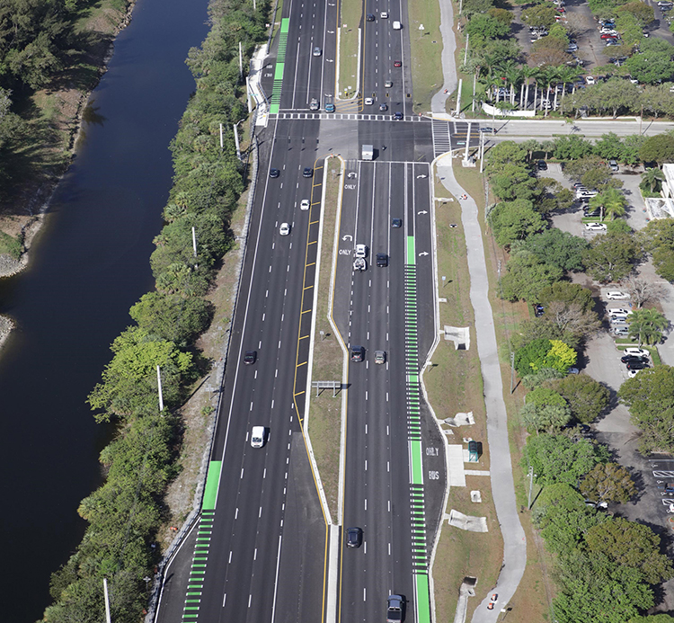
State Road Modifications
Program Overview
Purpose – Construct and enhance state roadways to advance the TPA’s vision
Projects – Safety, Complete Streets, Transit, Technology, Resiliency
Eligible Roads – State Roadways
Annual Funding – ~$20.4M/yr in state funds
5 Year Timeline – New phases typically programmed in new 5th year
Southern Blvd widening in 2020
Notes:
Look for projects in SRM that are major changes as well.

Slide 7
State Road Modifications
Priority Requests
Atlantic Avenue widening from west of Lyons Road to Jog Road
Accelerate funding for ROW & CST funding and reduce the amount of ROW required in order to minimize impacts and reduce costs
US-1 enhanced transit & multimodal corridor facilities
CST funding for the lane repurposing project in Boca Raton
CST funding for complete streets project in West Palm Beach
PE funding for lane repurposing project in Lake Worth Beach
Notes:
Look for projects in SRM that are major changes as well.

Slide 8
State Road Modifications
Priority Requests
Okeechobee Blvd enhanced transit & multimodal corridor facilities
CST funding for enhanced transit shelters
Lake Worth Rd enhanced transit & multimodal corridor facilities
Funding of transit signal prioritization to coincide with the transit signal prioritization on US-1 and Okeechobee Blvd
Federal Hwy at Spanish River Blvd
TPA requests construction funding
Okeechobee Blvd feasibility study
Next step after TPA planning study and Board direction
Notes:
Look for projects in SRM that are major changes as well.

Slide 9
Local Initiatives
Program Overview
Purpose – Advance lower-cost, non-regionally significant transportation projects identified by our communities
Projects – Complete Streets, Transit Capital, Non-Motorized Infrastructure, Freight Efficiency
Eligible Roads – Federal-aid Eligible Roadway Network
Annual Funding – ~$22M/yr in federal funds
Funding Reimbursement – $5M per project Max / $250K Min
5 Year Timeline – Design in year 3 / Construction in year 5
Notes:
Look for projects in SRM that are major changes as well.

Slide 10
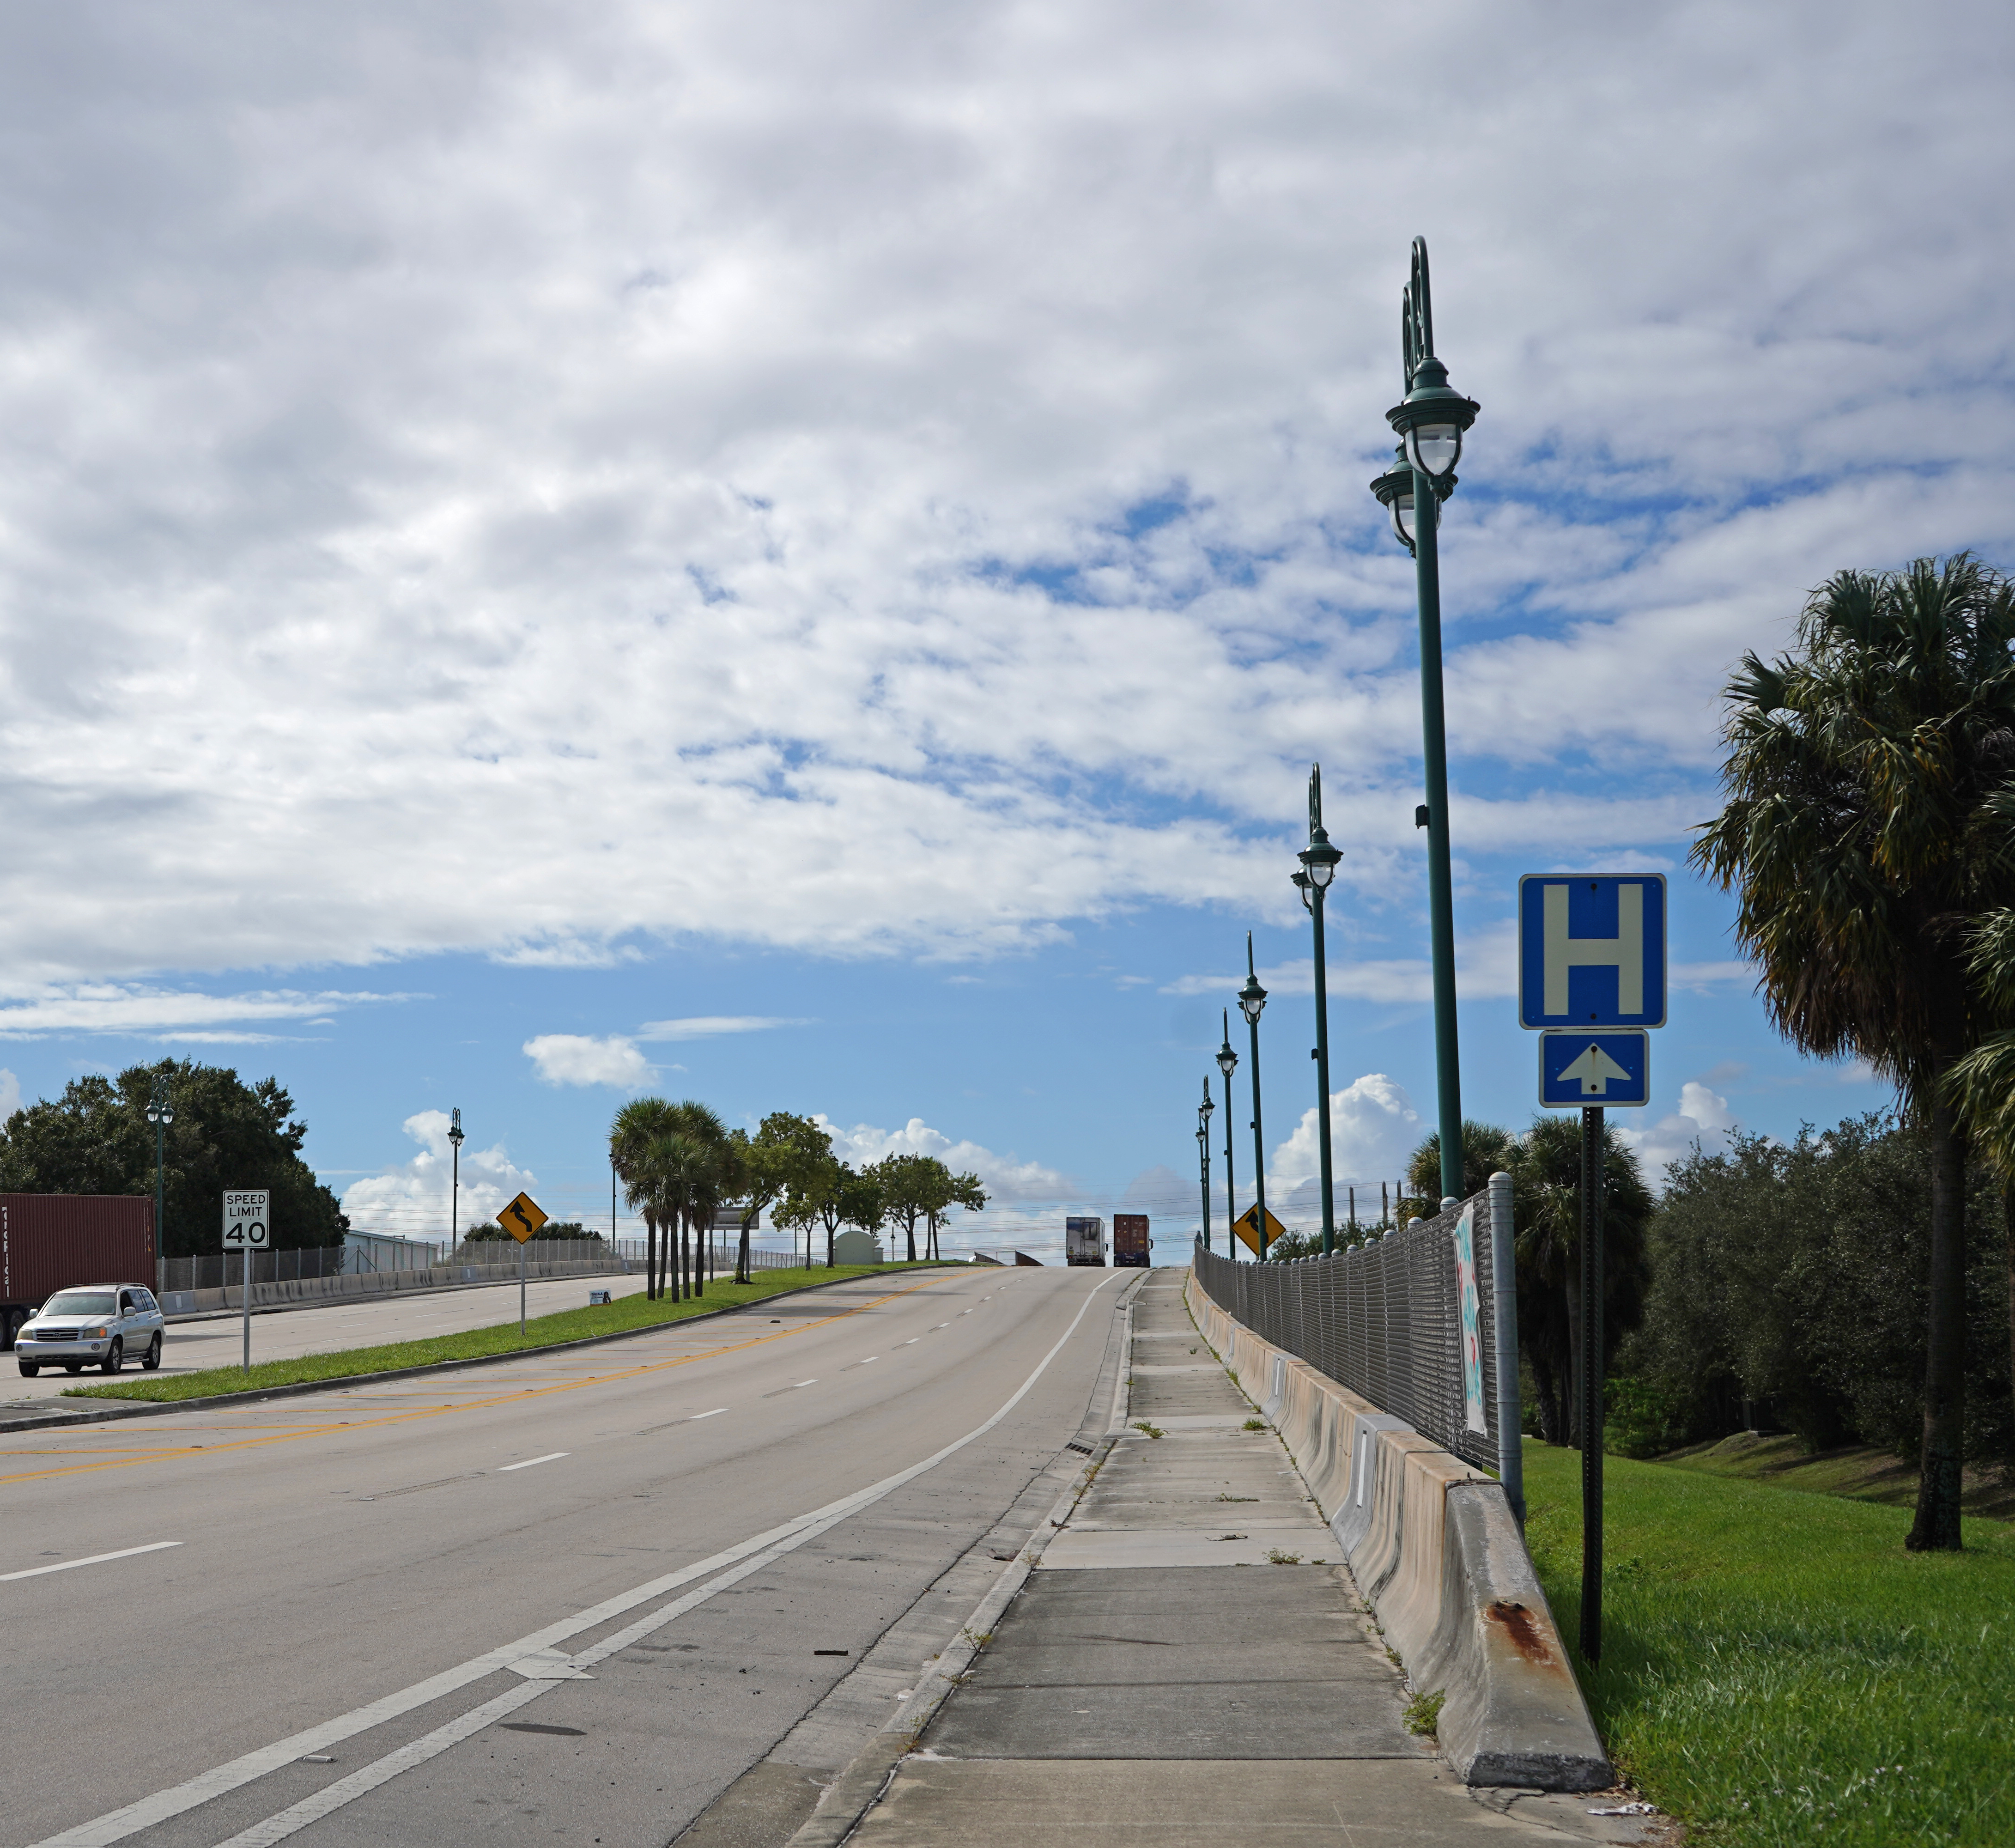
Local Initiatives
Program Overview
Purpose – Advance lower-cost, non-regionally significant projects identified by communities
Projects – Complete Streets, Transit Capital, Non-Motorized Infrastructure, Freight Efficiency
Eligible Roads – Federal-aid Eligible Roadway Network
Annual Funding – ~$22M/yr in federal funds
Funding Reimbursement – $5M per project Max / $250K Min
5 Year Timeline – Design in year 3/ Construction in year 5
Congress Ave lighting in Riviera Beach
Notes:
Look for projects in SRM that are major changes as well.

Slide 11
Local Initiatives
Priority Requests
Update programming of SU funding to support TPA planning and administration consistent with the FY 23-24 UPWP
Program construction/ implementation of seven (7) projects submitted from the 2022 Local Initiatives application cycle
Notes:
Look for projects in SRM that are major changes as well.

Slide 12
Local Initiatives
FY 22 Grant Projects
TPA Score | Applicant | Location | Description | Funding Request
25.2 | Boca Raton | SW 18th Street | 10’ share use pathway and missing crosswalks | $1,494,478
25.0 | SFRTA – Tri-Rail | Tri-Rail Service | Purchase one (1) passenger rail car | $3,500,000
24.5 | Palm Beach Gardens | Gardens Parkway | 5’ designated bike lane and 8’ sidewalk | $3,609,720
20.0 | Palm Tran | Palm Tran Service | Purchase four (4) electric buses | $5,000,000
Notes:
Look for projects in SRM that are major changes as well.

Slide 13
Local Initiatives
FY 22 Grant Projects
TPA Score | Applicant | Location | Description | Funding Request
17.8 | Delray Beach | Barwick Road | 10’ shared use pathway and new sidewalk | $1,658,549
15.0 | Palm Tran | Countywide | Bus Stop Improvements | $5,000,000
11.6 | Indian Trail Improvement District | Temple Blvd, Hall Blvd, 140th Ave | Seminole Speed Tables | $441,971
Notes:
Look for projects in SRM that are major changes as well.

Slide 14
Transportation Alternatives
Program Overview
Purpose – Non-motorized infrastructure & safe routes to school projects
Projects – Complete Streets, Bicycle and Pedestrian Infrastructure, Traffic Calming, Historic Preservation, Safe Routes to School
Eligible Roads – On and Off Federal-aid Eligible Roadway Network
Annual Funding – ~$3.3M/yr in federal funds
Funding Reimbursement – $1M per project Max / $250K Min
3 Year Timeline – Design in year 1 / Construction in year 3
Notes:
Look for projects in SRM that are major changes as well.

Slide 15
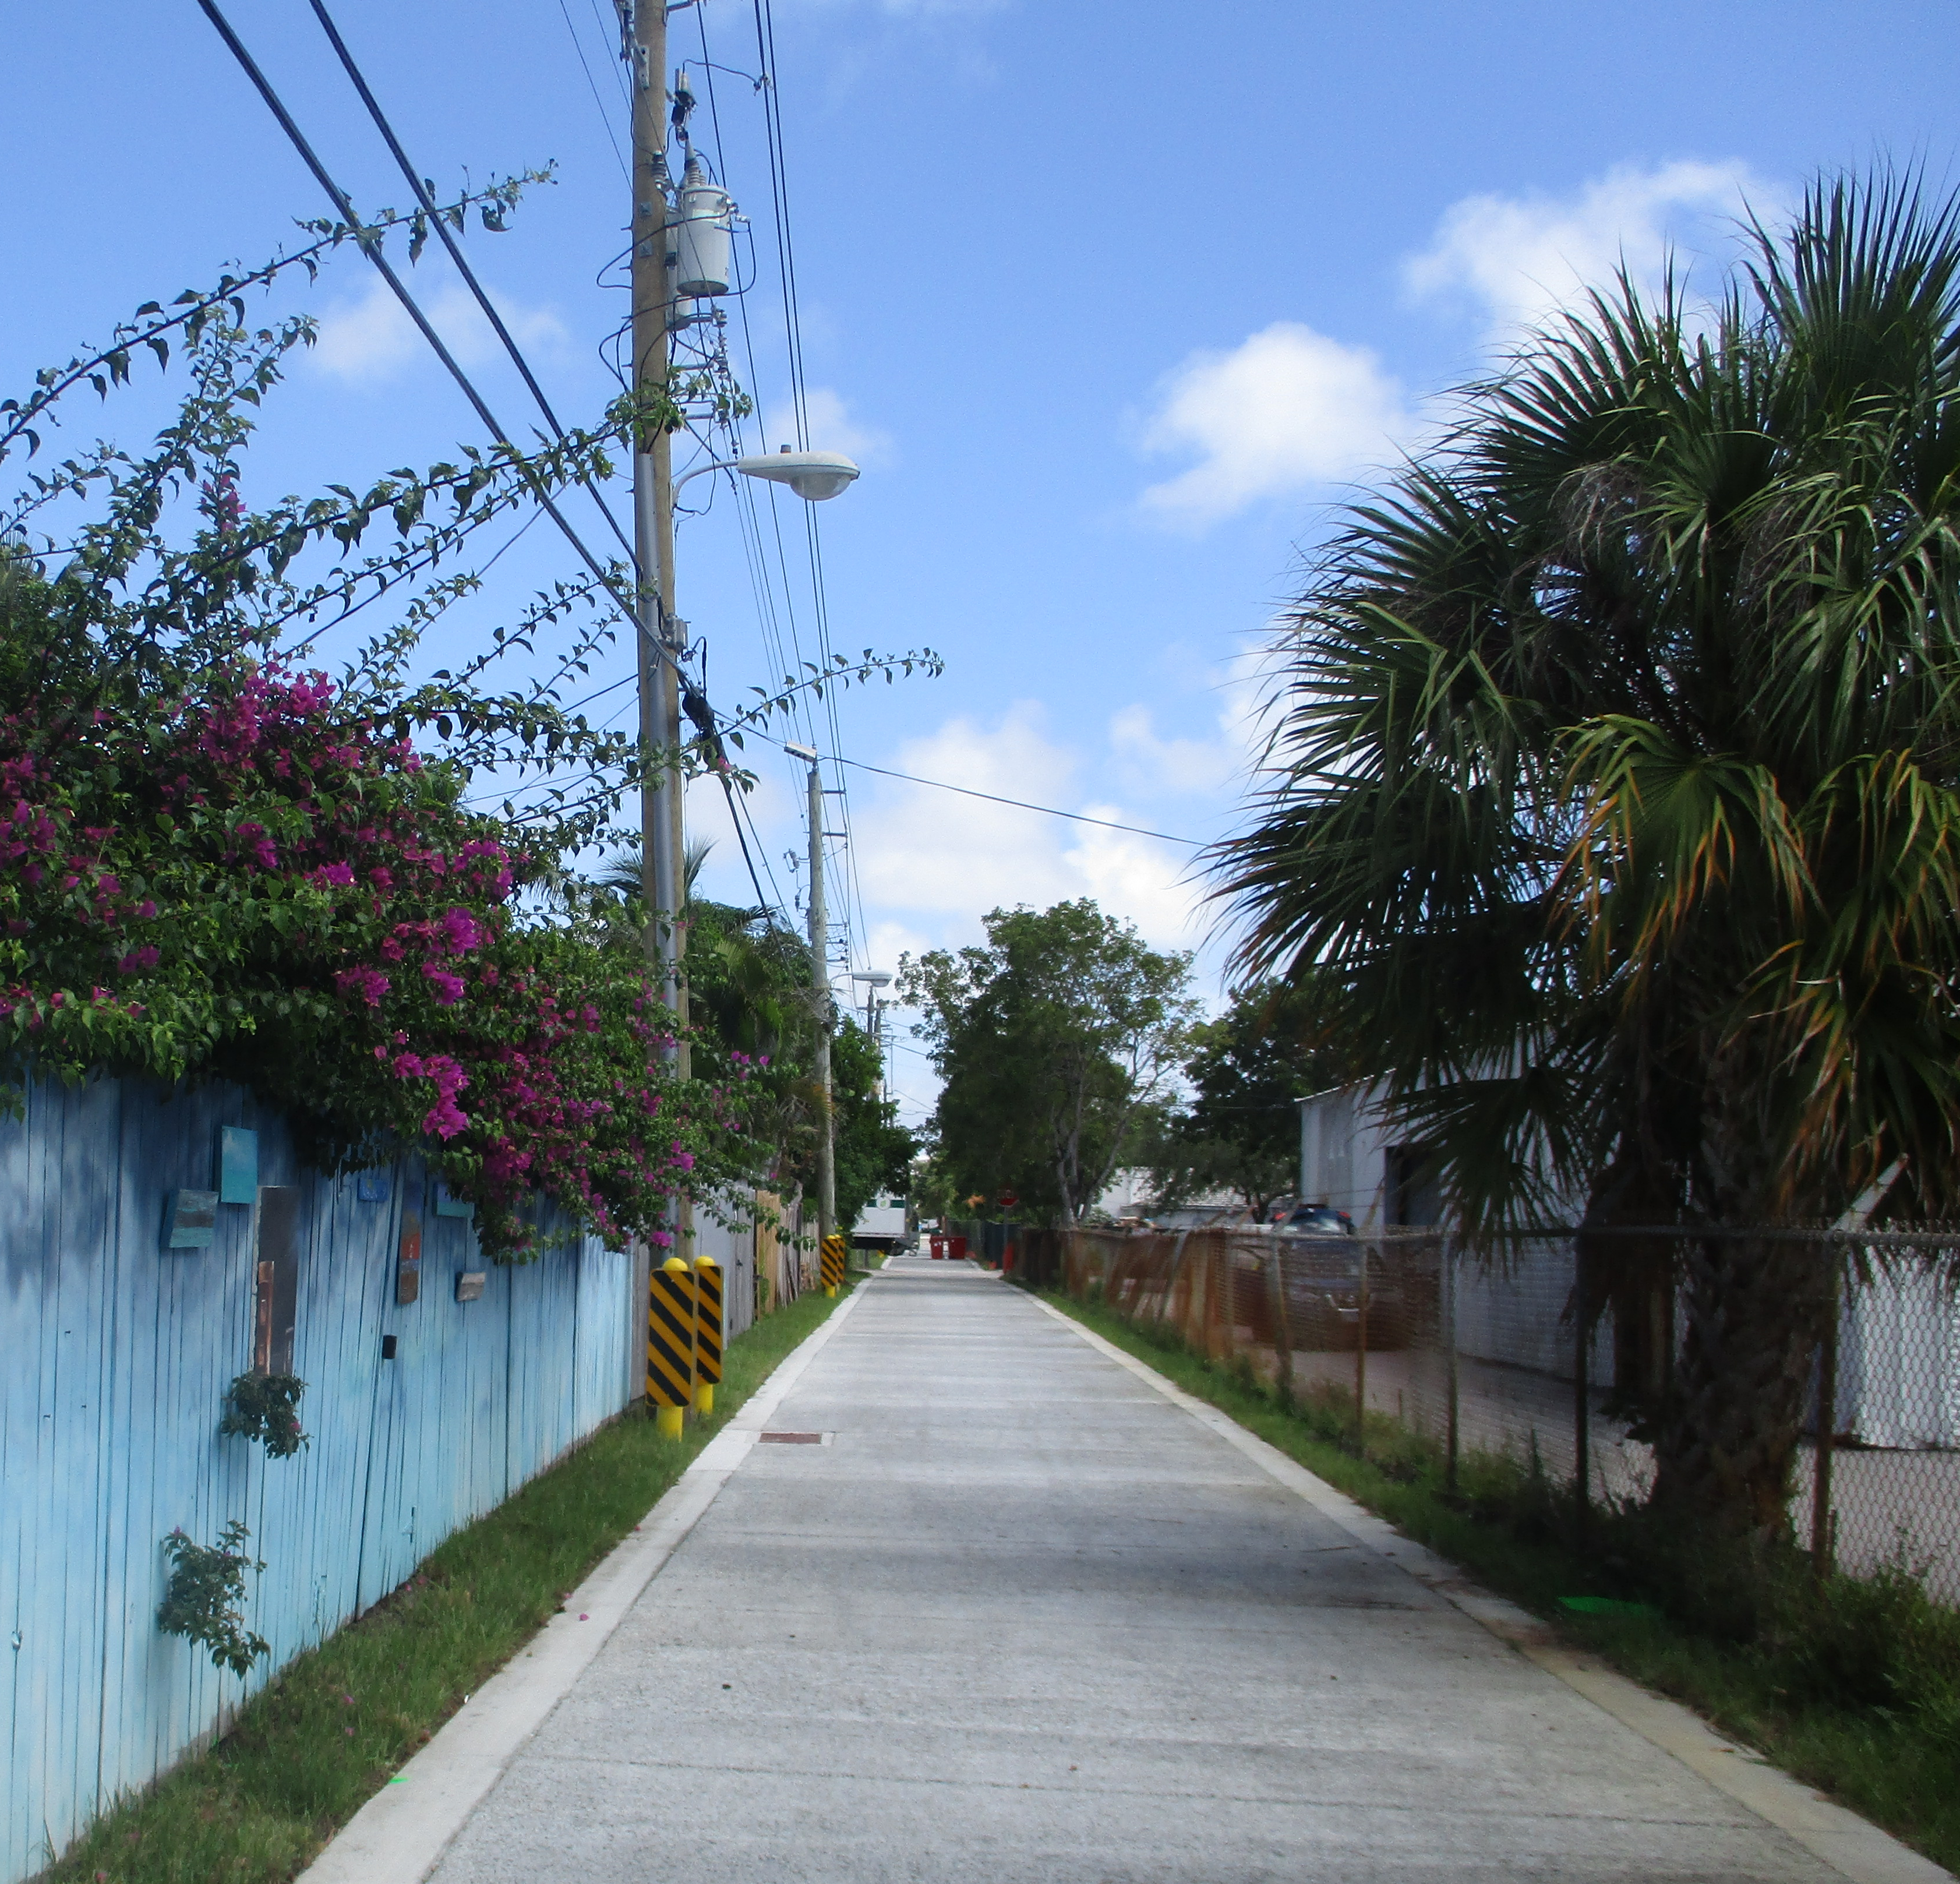
Transportation Alternatives
Program Overview
Purpose – Non-motorized infrastructure
Projects – Complete Streets, Bicycle and Pedestrian Infrastructure, Traffic Calming, Historic Preservation, Safe Routes to School
Eligible Roads – On and Off Federal-aid Eligible Roadway Network
Annual Funding – ~$3.3M/yr in federal funds
Funding Reimbursement – $1M per project Max / $250K Min
3 Year Timeline – Design in year 1 / Construction in year 3
Alleyway shared use path in Delray Beach
Notes:
Look for projects in SRM that are major changes as well.

Slide 16
Transportation Alternatives
Priority Requests
Program construction/implementation of four (4) projects submitted from the 2022 Transportation Alternatives application cycle
Notes:
Look for projects in SRM that are major changes as well.

Slide 17
Transportation Alternatives
FY 22 Grant Projects
TPA Score | Applicant | Location | Description | Funding Request
44.2 | Indian Trail Improvement District | Hamlin Blvd, Grapeview Blvd, Citrus Grove Blvd | 10’ share use pathway and expand existing sidewalk to 8’ | $985,319
42.3 | Palm Beach Gardens | Fairchild Ave | Buffered bicycle lanes and 8’ pathway on south side of roadway | $1,000,000
27.8 | Royal Palm Beach | Various Locations | Pedestrian and bicycle network wayfinding signs | $594,197
26.5 | West Palm Beach | 49th Street | ADA curb ramps, sidewalks, traffic calming and sharrows | $773,475
Notes:
Look for projects in SRM that are major changes as well.

Slide 18
Additional Information
TPA Website Links for LOPP
TPA Website Links for Grant Programs
Stay Tuned for the Next Grant Cycle this Fall
PalmBeachTPA.org/Priorities
PalmBeachTPA.org/Funding
Notes:
Look for projects in SRM that are major changes as well.

Slide 19
Advisory Committee Votes and Input
Technical Advisory Committee (TAC)
Recommended Adoption 18-5, with friendly amendment to add “and Board direction” to project 18-1c.
West Palm Beach Representatives dissented due to the inclusion of State Road 7 extension project. Palm Beach County and Jupiter Representatives dissented due to concerns with the Okeechobee Blvd & State Road 7 Multimodal Corridor Study
Citizen’s Advisory Committee (CAC)
Recommended adoption unanimously
Vision Zero Advisory Committee (VZAC)
Recommended Adoption 10-2
Palm Beach County Representatives dissented due to concerns with the Okeechobee Blvd & State Road 7 Multimodal Corridor Study

Slide 20
Motion to Adopt the FY 24-28 List of Priority Projects

