Slide 1
Transportation Disadvantaged Service Plan (TDSP) Major Update
August 24, 2022

Slide 2
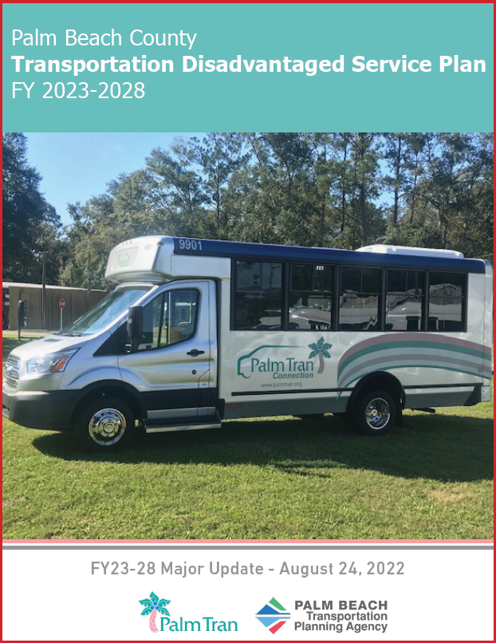
What is the Transportation Disadvantaged Service Plan
Transportation Disadvantaged Service Plan (TDSP)
Annual update every year with a major update every 5 years
Developed by the Designated Official Planning Agency (DOPA) and Community Transportation Coordinator (CTC)
The Florida Commission for Transportation Disadvantaged (CTD) requires a TDSP to be developed for each service area recognized by the CTD
Notes:
The Transportation Disadvantaged Service Plan (TDSP) serves as a comprehensive operational guidebook outlining the services and service parameters that govern public transportation for the TD service in Palm Beach County.
The Commission requires a Service Plan for each area recognize by the CTD
Today I am covering the updates for this TDSP major update.
The TDSP will undergo annual updates for years two through five, due prior to July 1 of each subsequent year.
DOPA is TPA, CTC is Palm Tran, and CTD is a governing body comprise of 6 members

Slide 3
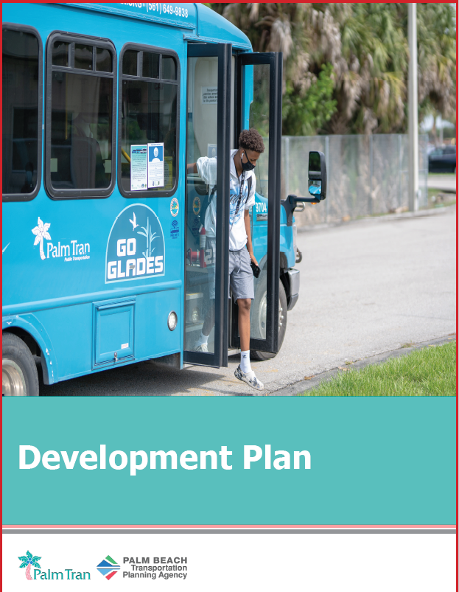
TDSP Key Components
CTD-required components:
Development Plan
Service Area Profile / Demographics
Service Analysis
Goals, Objectives, and Strategies
Implementation Schedule
Service Plan
Operations
Cost/Revenue Allocation and Rate Structure Justification
Quality Assurance
CTC Evaluation
Notes:
The TDSP is divided into 4 sections the Development Plan, Service Plan, Quality Assurance and Appendices.
The Development Plan Section covers physical characteristics of the county such as major trip generators, population, needs assessment and demand estimates.
Palm Tran has 5 goals with a number of objectives (17) and strategies (37) with set targets to measure performance.
The Service Plan is a description of the operational components for the County’s fixed route and paratransit system and coordinated contracts.
The TPA facilitates the annual evaluation of Palm Tran Connection. This year we went through a the designation process so there wasn't any evaluation. From February 22 to May 24, 2023 staff will conduct an evaluation

Slide 4
Updates: Data
Population Densities
Distribution of Age Groups
Annual Household Income Distribution
Educational Attainment
Labor Force
Vehicle Availability
Population TD Forecasts
Critical Need - Severely Disabled TD Population
 | Not Low Income | Low Income | Totals
Non-Elderly | 6,399 | 2,563 | 8,962
Elderly | 38,966 | 5,163 | 44,130
TOTAL | 45,365 | 7,726 | 53,092
Notes:
Staff used US Census data to update the tables throughout the TDSP.
More resource: Anyone can visit our Community Profiles web map application for additional US Census data; it is organized by local jurisdictions (PalmBeachTPA.org/Profiles)
Table 1, shows the top 5 largest cities ( Boca Raton, Boynton Beach, Delray Beach, Wellington and West Palm Beach
Table 2, distribution of age groups
Table 3, Annual Household Income
Table 4, Educational Attainment
Table 5, Labor Force
Table 6, household vehicle ownership
Table 7, Forecasts of TD population shows a growth from 2019 - 2019

Slide 5
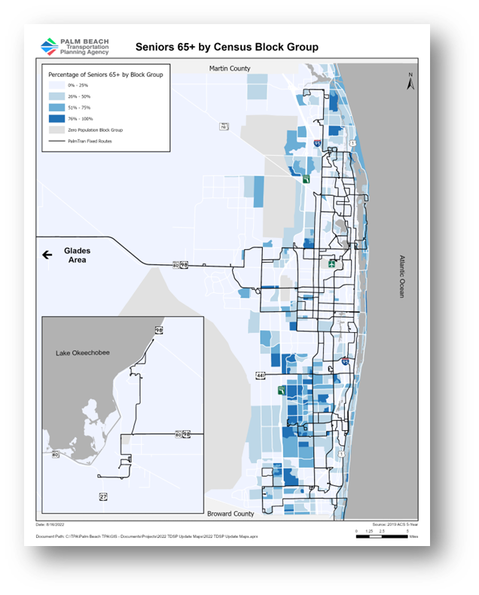
Updates: Maps
Land Use
System Map
Seniors 65+
Persons Below Poverty Level
Minority Population
Notes:
Staff invested lot of time updating maps. There are 3 maps in the appendix section (senior, person below poverty level and minority population).
The Land Use (zoning map), and system map with ADA buffer zone are in the Development Plan Section

Slide 6
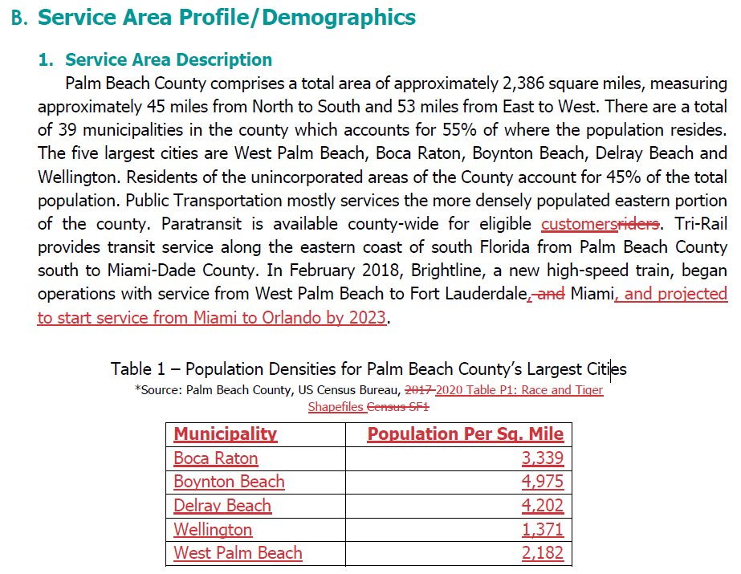
Updates: Required Documents
LCB Membership List
Roll Call Vote Sheet
Palm Tran Data
Language Update
Document Design
Notes:
We updated a series of documents, which are more administrative to keep items current

Slide 7
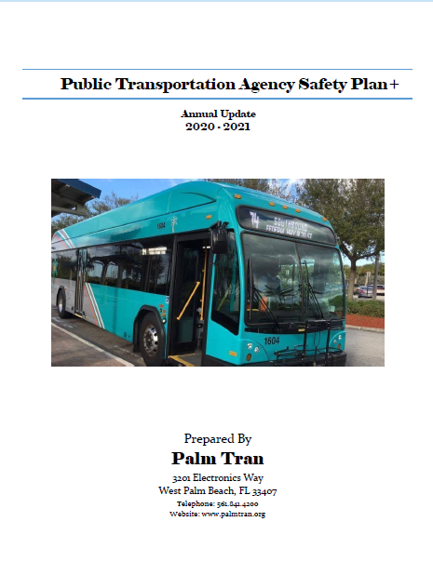
Updates: Palm Tran
System Safety Program Plan (SSPP) >> Public Transportation Agency Safety Plan
Terms “Rider” >> “Customer”
New information >> Recertification Process and Categories
Vehicle Inventory Updated
Notes:
The PTASP or Safety Plan is a guiding document Palm Tran is developing to continue their effort to improve safety. Which follows the 4 components of Safety Management System
Safety Management Policy
Safety Assurance
Safety Risk Management
Safety Promotion
The Final PTASP will be included upon execution. Final draft of PTASP must be submitted to the FTA by no later than October 1st by Palm Tran. Once Palm Tran has new PTASP, then they will send to TPA.
In the effort to improve service Palm Tran address transit riders as “Customer”
All paratransit service customers must be recertified for eligibility every three (3) years. It’s a quality control process to better serve customers.

Slide 8
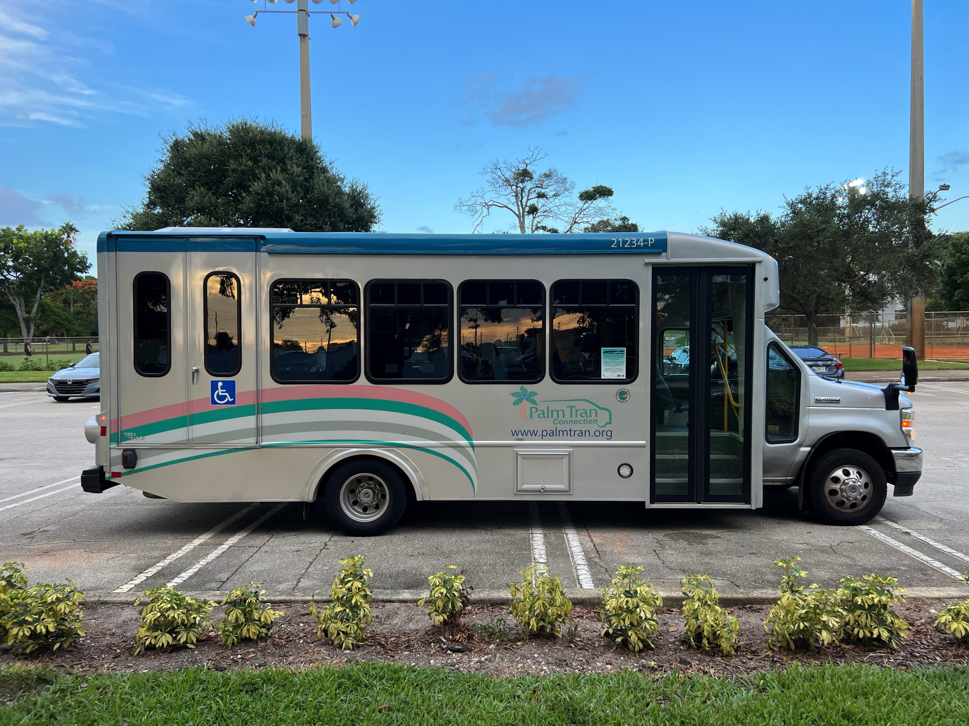
Next Steps
LCB Approval
TPA submittal to CTD due Nov. 1, 2022
Annual Updates Fall 2023

Slide 9
Motion to Approve FY 23-28 TDSP Major Update

Slide 10
Motion to Adopt FY 23 LCB By-Laws

Slide 11
Motion to Adopt FY 23 Grievance Procedures

