Slide 1
Unified Planning Work Program (UPWP) FY 2021/2022
Revision #4 Amendment

Slide 2
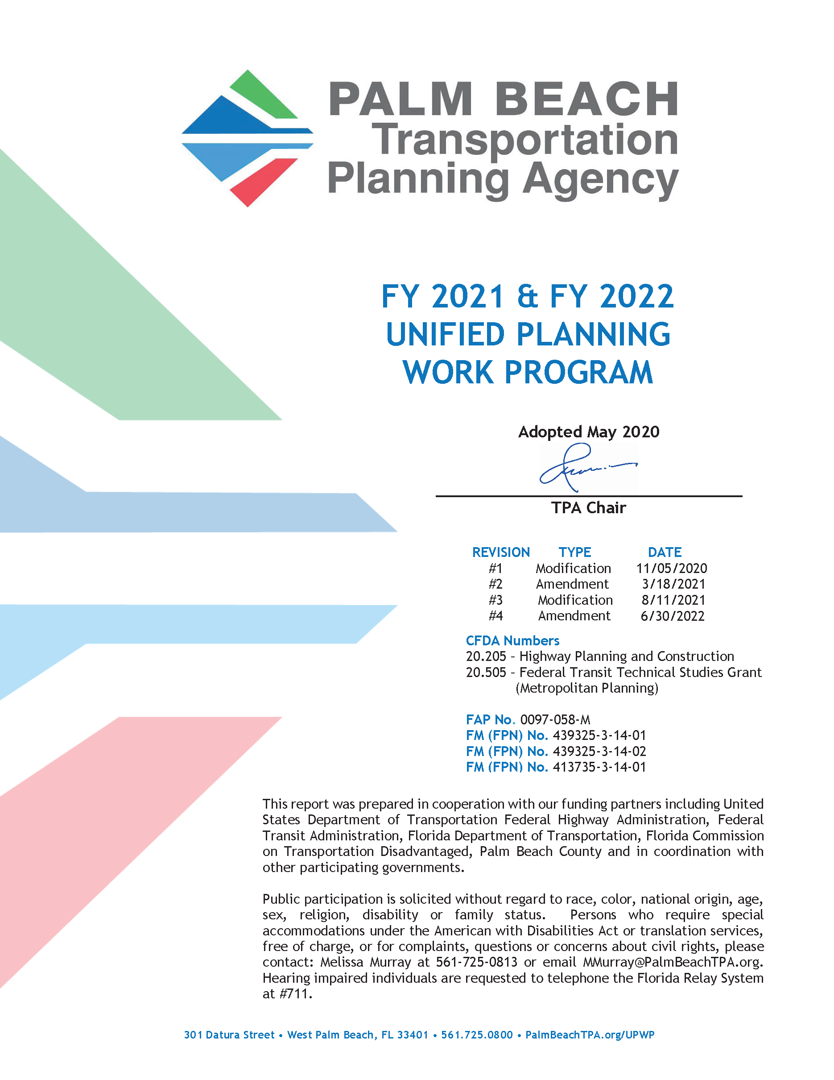
UPWP Overview
2-Year Operational Plan & Budget
July 1, 2020 - June 30, 2022
Application for Federal Grant Funds
Includes tasks and identifies:
What? Deliverables
Who? Staff and/or consultants
When? Completion dates
How Much? Budget and funding source
UPWP closed June 30, 2022

Slide 3
Amendment Changes
Fiscal Year | FHWA – PL | FHWA – SU | FTA 20 & 21 | FTA 19
2021 | - 124,500 | - 499,890 | - 54,569 | - 675
2022 | + 124,500 | + 499,980 | + 54,569 | + 675
Redistribute FHWA-SU funding to fully utilize perishable funds
Reallocate unused funds from FY 2021 to FY 2022

Slide 4
Motion to Ratify FY 2021-2022 UPWP Revision #4 Amendment

