Slide 1
Palm Beach TPA Interim Director’s Report
April 12, 2022

Slide 2
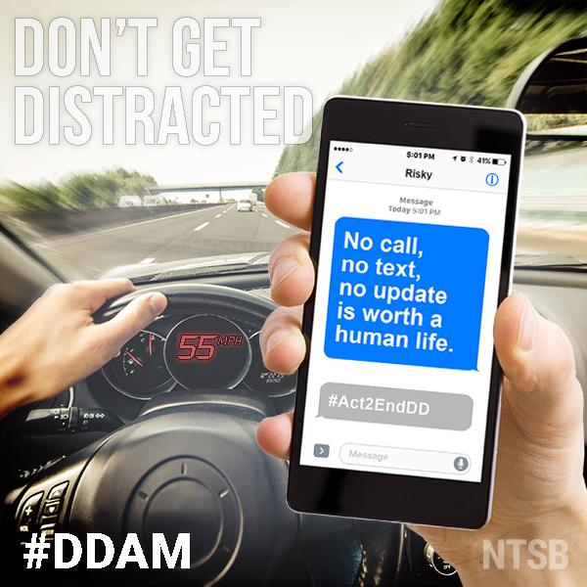
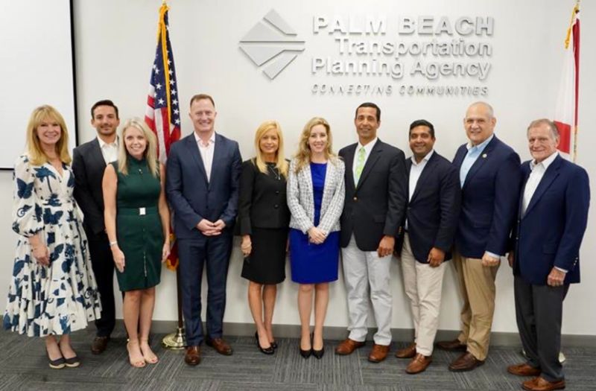
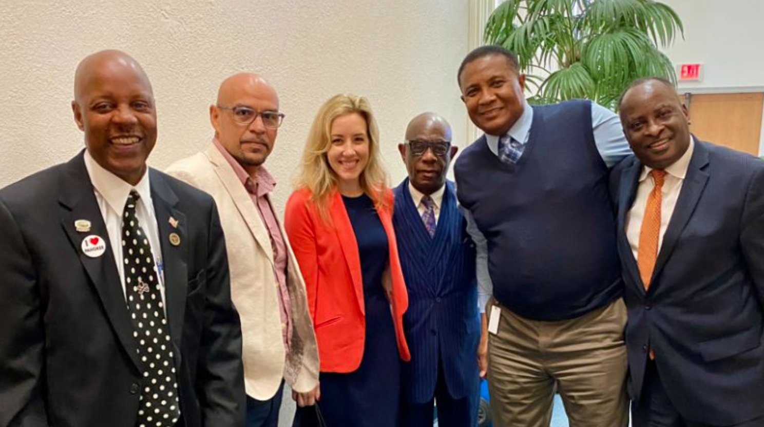
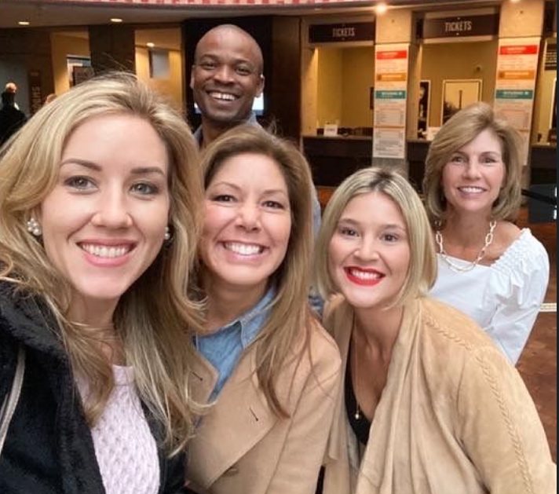
Interim Director’s Report – Since March 28
New: TPA FDOT Weekly Coordination meetings
RAISE Grant Letters of Support: SFRTA, Brightline, WPB
March 31: Mobility & Economic Development Panel PalmBeachTPA.org/MobilityPanel
April 4 & 11: Palm Beach County Perspective Mobility Episodes
April 5: BCC MOA for SR80 Lighting – FY22, FY23 – FY26
April 7: New FDOT Secretary Jared W. Perdue Appointed
April 6-8: PBC Economic Council Leadership Trip
April Distracted Driving Awareness Month
April 11-15 National Work Zone Safety Week

Slide 3
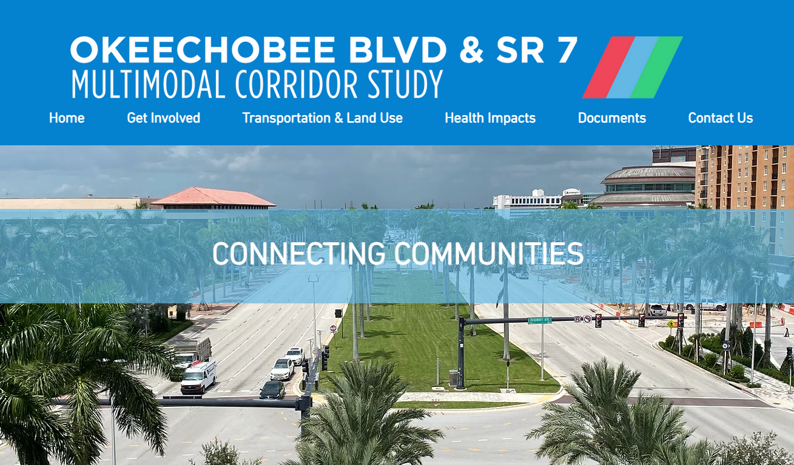
Interim Director’s Report - Upcoming
April 15 FDOT & TPA CY 2021 Joint Certification
April 21: TPA Board Meeting
April 21: Multimodal Cities Panel at CoMotion Miami: CoMotionMiami.com
April 27-28: MPOAC Meetings
May 5: National Bike & Roll to School Day: WalkBiketoSchool.org
May 10: Okeechobee Blvd. & SR 7 Workshop: PalmBeachTPA.org/Okee
May 13: TPA Vision Zero Workshop: PalmBeachTPA.org/VZWorkshop
May 26-27: Peer Exchange with Austin, TX – Save the Date

Slide 4
PalmBeachTPA.org
Valerie Neilson, AICP
INTERIM EXECUTIVE DIRECTOR
VNeilson@PalmBeachTPA.org

